Slide 1

HOW TO CAPITALIZE ON SYMPATHY TRIBUTE SALES
By
McAdams Floral
and
InLieuOfFlowers.info
Original content by McAdams Floral, Inc. Please do not distribute without permission.

Slide 2
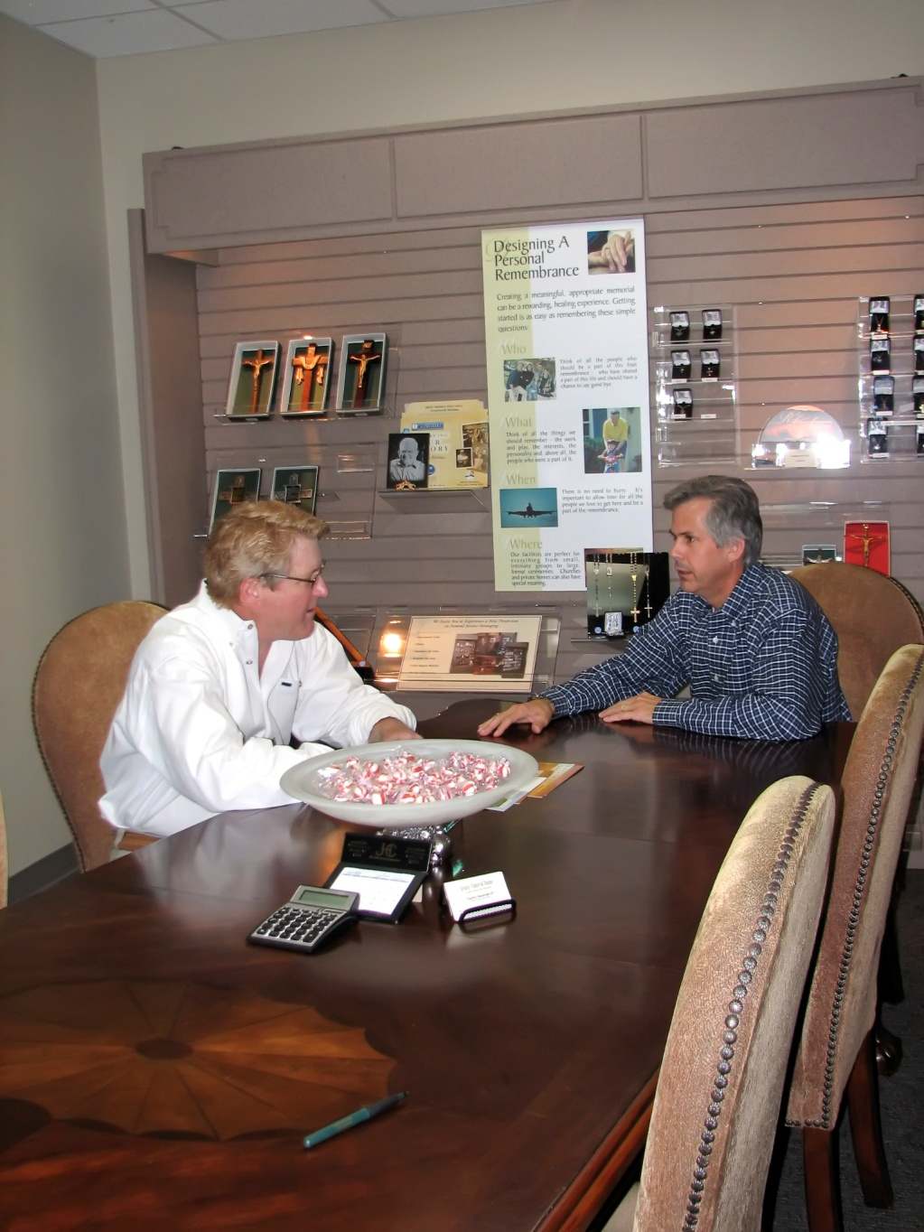
Visit With Funeral Director
Talk with funeral directors!
Inquire why families ask for “In Lieu of Flowers.”
Ask how this terminology comes up.
Ask them what your floral shop can do to make their job easier.
Ask if they would mind giving you any areas of improvement they see.
Original content by McAdams Floral, Inc. Please do not distribute without permission.

Slide 3
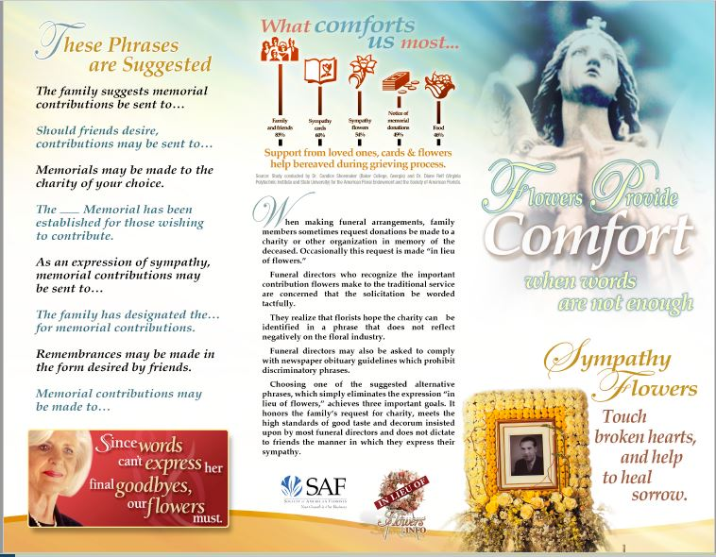
Hand Out “In Lieu of Flowers” Tri-Fold
Front page
Original content by McAdams Floral, Inc. Please do not distribute without permission.

Slide 4
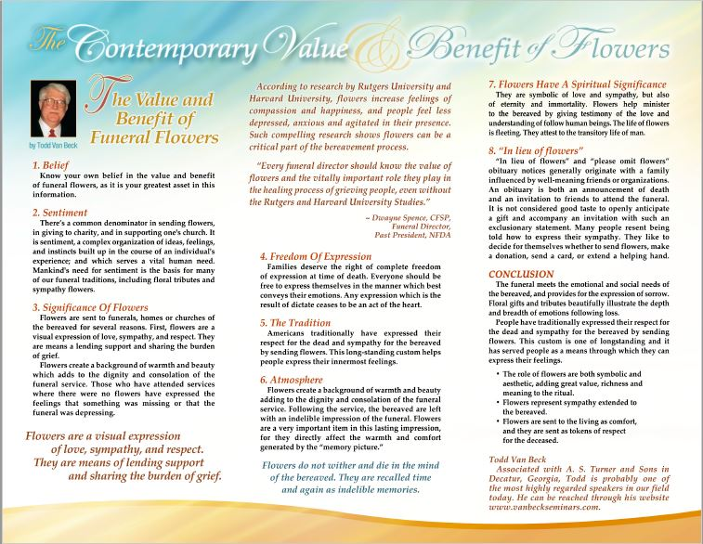
Hand Out “In Lieu of Flowers” Tri-Fold
Back page
Original content by McAdams Floral, Inc. Please do not distribute without permission.

Slide 5
Media Talking Points for “In Lieu of Flowers”
(ILOF can “influence”….do not use the word “effect”)
ILOF notices occur from time to time in the newspaper obituaries. These requests generally originate with the family, who have been influenced by well-meaning friends or organizations.
Often times, the ILOF terminology is used to encourage charitable gifts but not necessarily to discourage other tribute expressions. Most families sincerely appreciate all personal expressions and may later regret having too few flowers at the funeral.
While a monetary donation is a worth tribute, there is really not substitute for beautiful flowers at a sympathy service. They comfort the living as they commemorate the life of the deceased.
Flowers are a visual expression of love, sympathy, and respect. They are a means of lending support and sharing the burden of grief.
Flowers create a background of warmth and beauty, adding to the dignity and consolation of the funeral service. Flowers leave an indelible impression of the funeral service. Flowers do not wither and die in the mid of the bereaved.
In a Society of American Florist research study, 99 percent of the grief therapists surveyed thing the rituals surrounding the death and funeral are an aid in the grieving process….and 80% of them thought receiving flowers was an aid.
A later research by Dr. Nancy Etcoff showed that flowers can have profound positive effects on our emotions. The bereavement process is a time of worry, anxiety, and many sad emotions….flowers have a calming effect.
Up to 80% of a Charity Organization’s donations can come from memorial contributions. A lot of organizations have brochures at the funeral home.
Alternate phrases: Memorial contributions may be made to … or the …. Memorial has been established for those wishing to contribute.
Original content by McAdams Floral, Inc. Please do not distribute without permission.

Slide 6
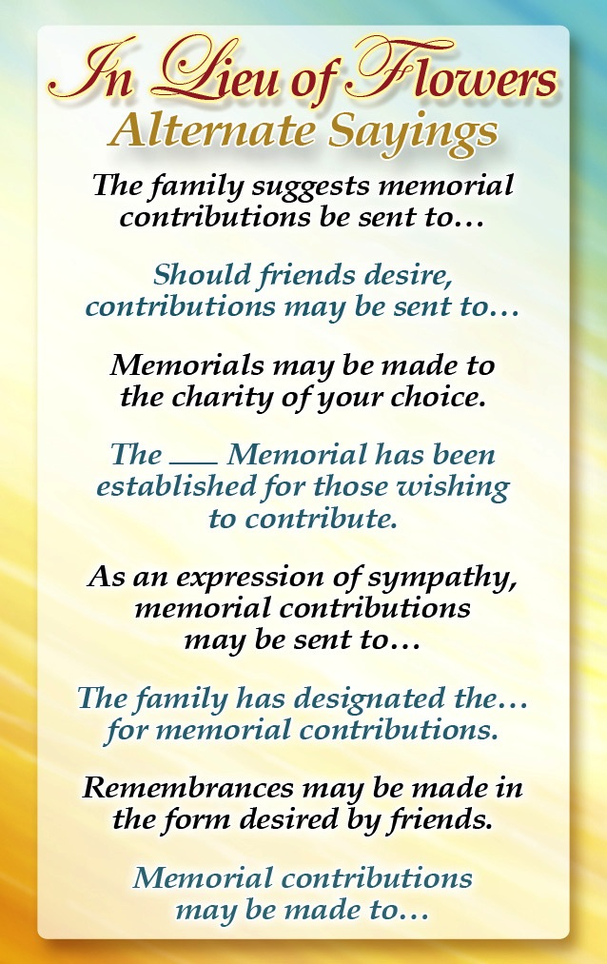

Hand Out Alternate Sayings Card
Ask if they could keep this tasteful wallet size card in the consultation room for quick reference to alternate sayings to ILOF.
If the funeral director is receptive to the idea, follow up with a gift of a wood/décor card holder and extra cards.
Reverse side of Alternate Sayings Card
Original content by McAdams Floral, Inc. Please do not distribute without permission.

Slide 7

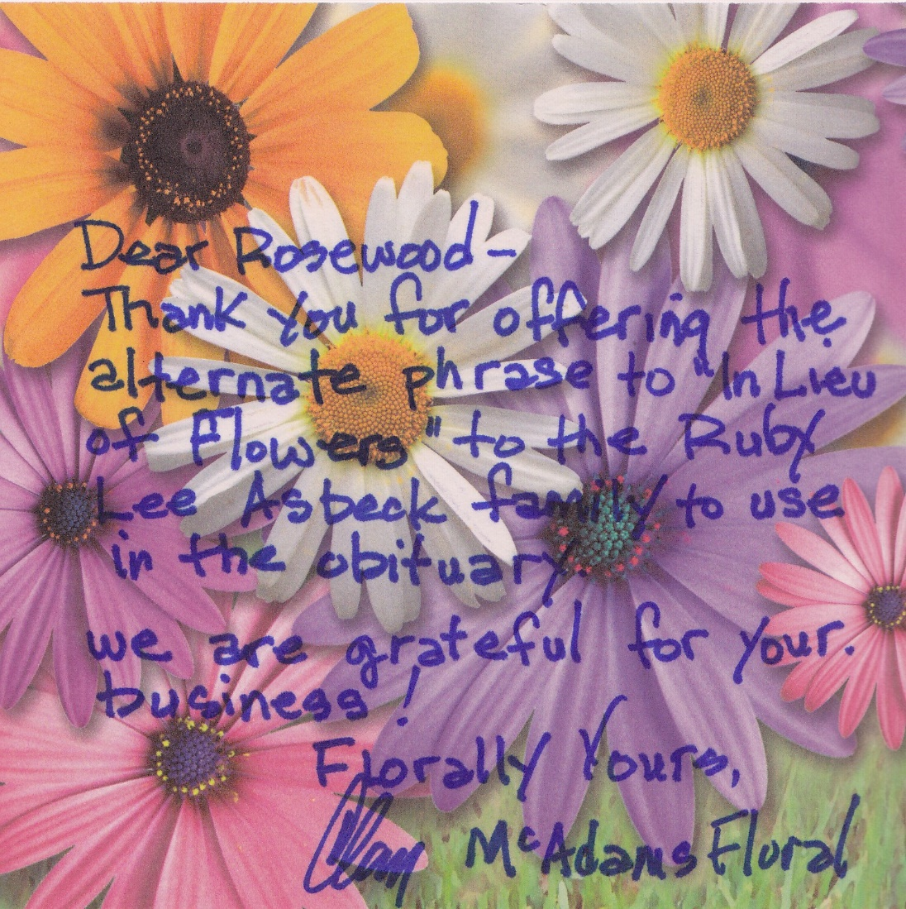
Thank FDs for Suggesting Alternate Sayings
Send a ‘thank you’ when you see an alternate phrase used in an obituary
Even if they had nothing to do with the decision, the note reminds them of the issue and makes them aware you are closely watching the listings.
Original content by McAdams Floral, Inc. Please do not distribute without permission.

Slide 8
Advertising/Promotional Marketing
Original content by McAdams Floral, Inc. Please do not distribute without permission.

Slide 9
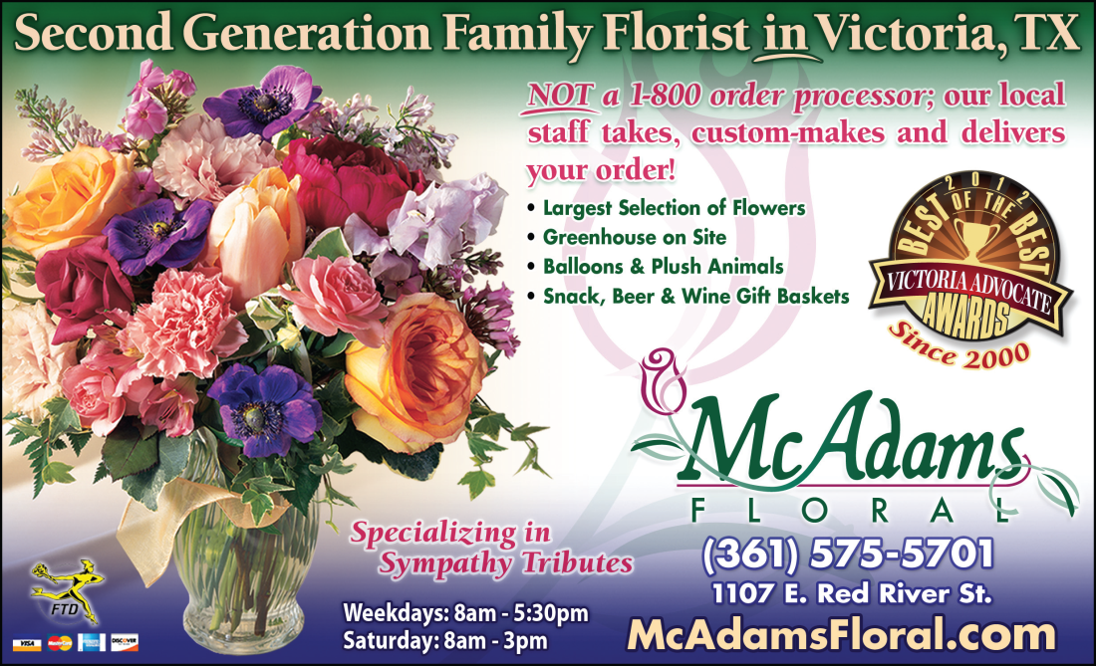
Branding Your Business
Brand your shop as THE funeral florist in town.
  Funeral directors and support staff feel more comfortable distributing a card for a dedicated funeral florist.
Funeral-related consumers feel they have made the right decision in calling a ‘dedicated funeral florist.’
Add ‘Funeral Specialist’ to your Yellow Pages ad, website(s), and all search engine “local Listings.”
Original content by McAdams Floral, Inc. Please do not distribute without permission.

Slide 10
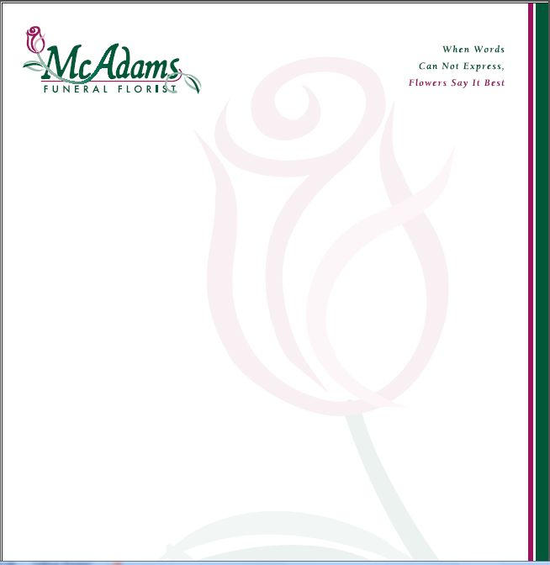
Branding Your Business
Carry the branding of your firm as a professional funeral florist through to your stationary, using a dedicated “sympathy mast” letterhead, for use when communicating with funeral directors and family members of the deceased.
Original content by McAdams Floral, Inc. Please do not distribute without permission.

Slide 11
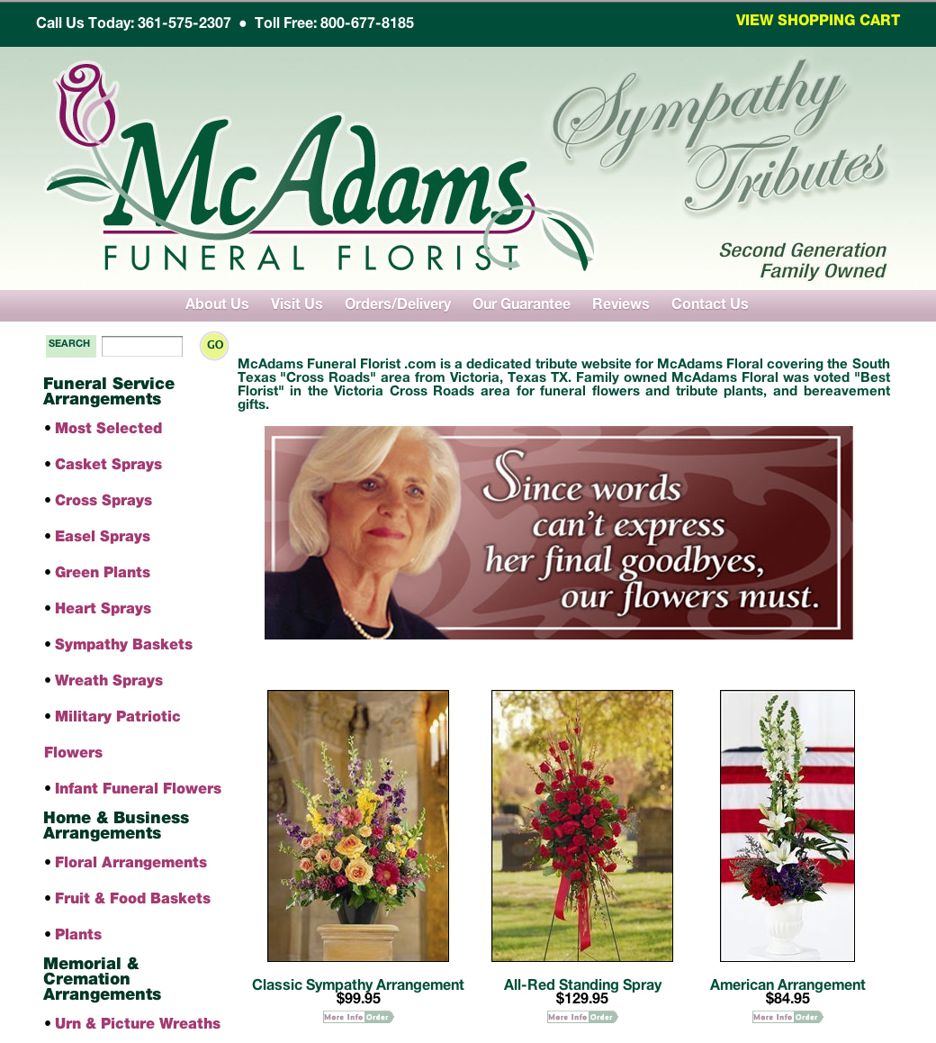
Dedicated Funeral Website
(or Sub-Domain of Current Website)
Offers the same benefits as a dedicated funeral business card.
Is the user-friendly way to present individual sympathy products categories.
Allows for sympathy-appropriate design and coloration.
Simplifies search engine optimization (SEO) for better SERP rankings.
Original content by McAdams Floral, Inc. Please do not distribute without permission.

Slide 12
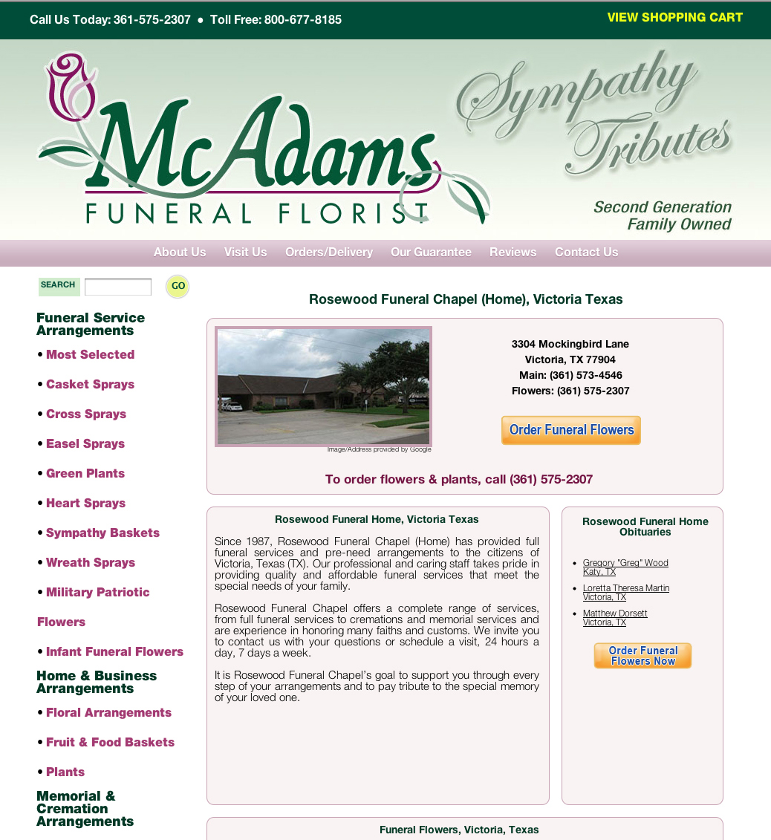
Dedicated Funeral Home Landing Pages
A dedicated landing page will have a higher ranking than a funeral home page listing your firm’s contact information.
You can control important optimization factors: meta tags and description, page titles and keyword use/density.
Google commonly places the landing page directly below the listing of funeral home website URLs.
Dedicated landing page provides good organic ranking results for “Funeral flowers to Rosewood Funeral Home”.
Original content by McAdams Floral, Inc. Please do not distribute without permission.

Slide 13
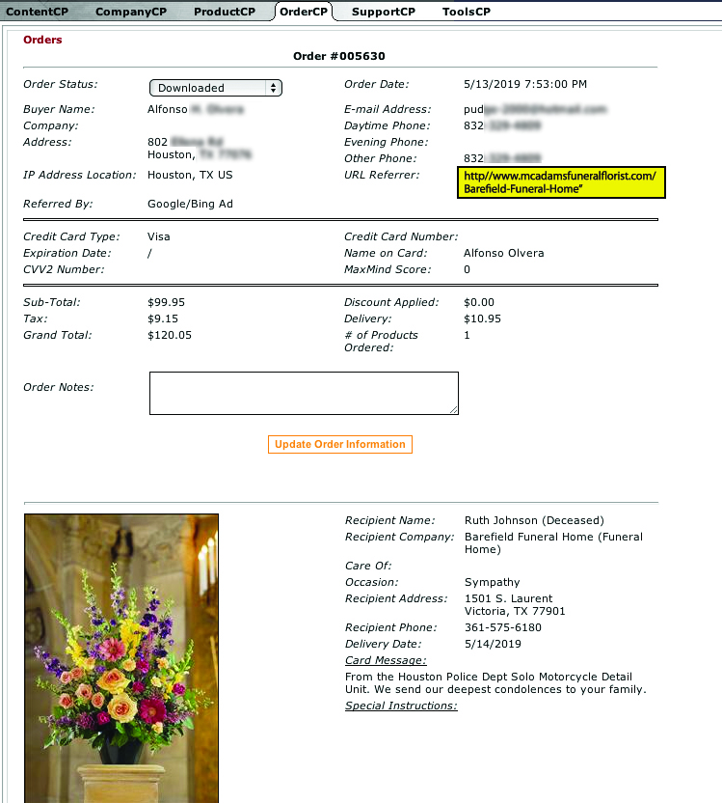
Funeral Home Landing Page Orders
Orders from funeral home landing pages can contribute thousands of dollars to your revenues each year.
Original content by McAdams Floral, Inc. Please do not distribute without permission.

Slide 14
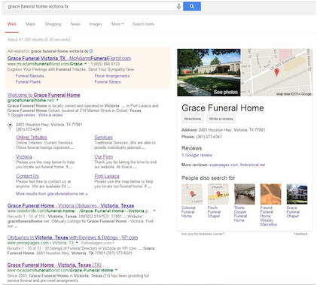
Google AdWords for Funeral Home Names
If the funeral home landing page does not show on Google page 1, use Google AdWords to get page 1 exposure.
The Image is a Google desktop search for "Grace Funeral Home Victoria TX" illustrating top-level AdWords exposure
Note: This Marketing has been on hold since 2015. The Wife needed (still needs) lots of medical attention and this type of marketing requires time and dedication to be successful"
Original content by McAdams Floral, Inc. Please do not distribute without permission.

Slide 15
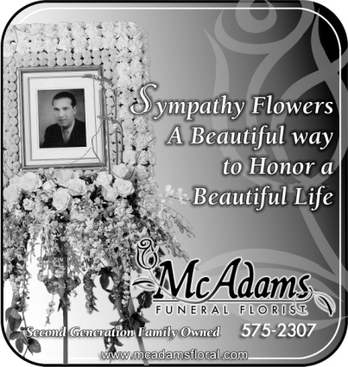

B&W/Color Newspaper Ads
Advertising in the major newspapers of larger cities and towns may not be cost effective, but do not neglect the newspapers of smaller communities or districts in your service area.
Build TOMA (“Top of Mind Awareness”) around your firm’s commitment to being THE funeral florist (branding).
Place ads on the newspaper obituary pages or (as is our policy) on the opposite page.
Always negotiate placement rates on print frequency, as most papers offer varying or discounted rates.
Think about advertising in the Sunday edition, as people generally have more time to read this higher circulation issue.
Original content by McAdams Floral, Inc. Please do not distribute without permission.

Slide 16
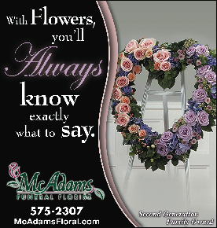
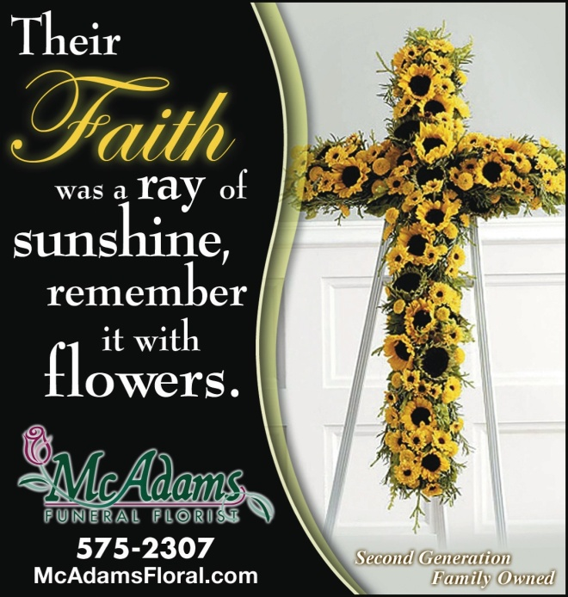
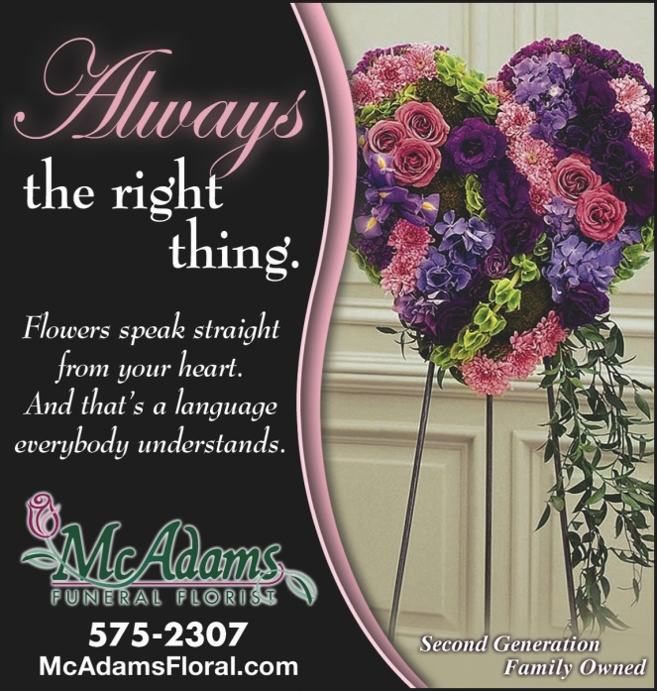
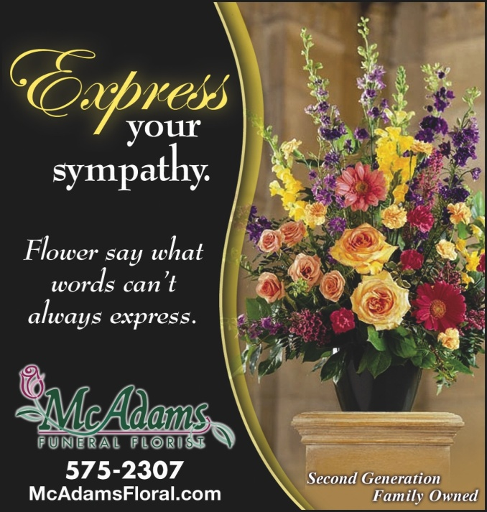
Original content by McAdams Floral, Inc. Please do not distribute without permission.

Slide 17
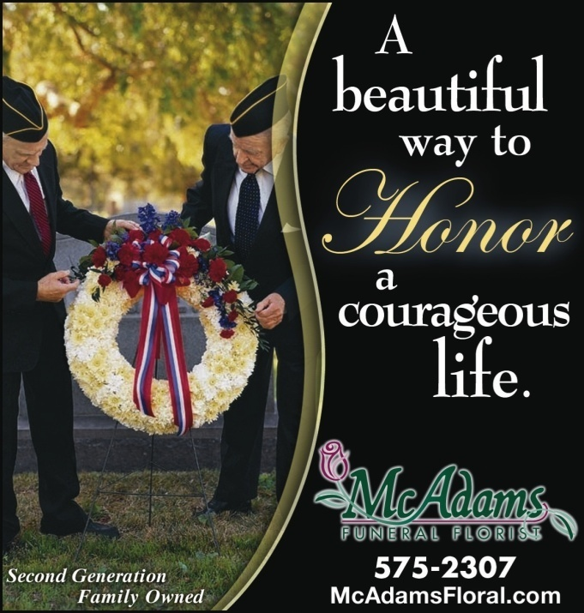
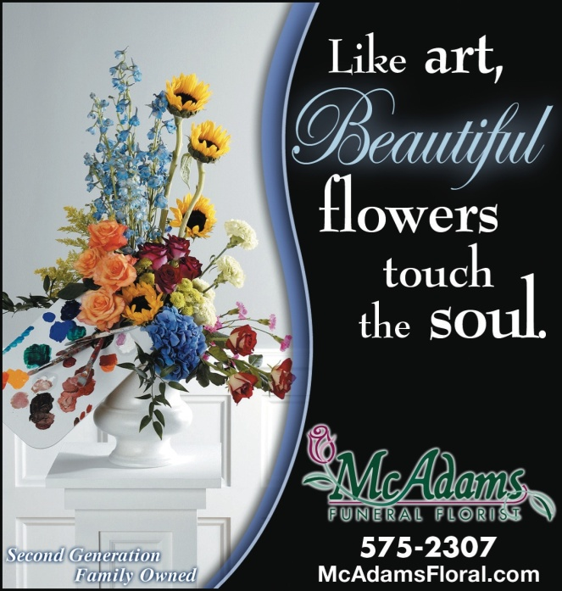
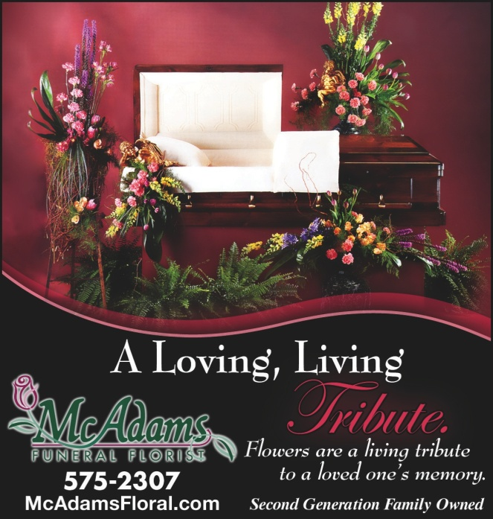
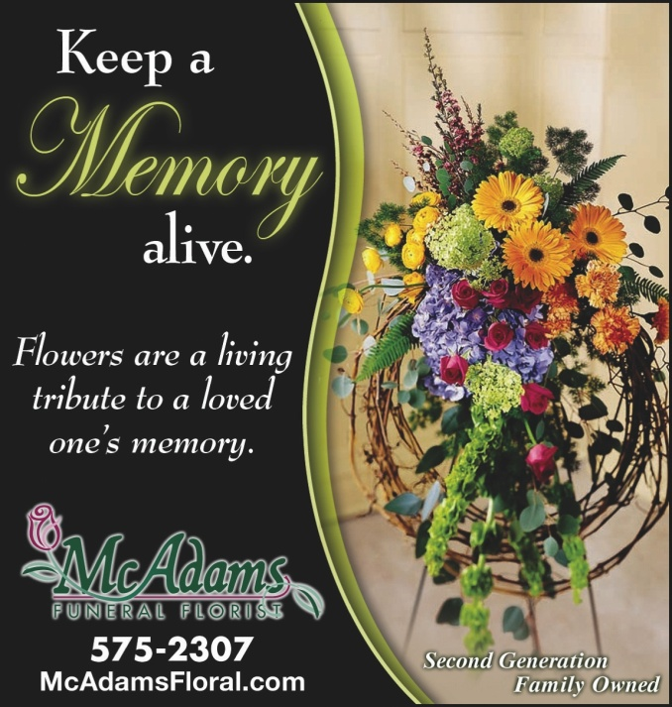
Original content by McAdams Floral, Inc. Please do not distribute without permission.

Slide 18
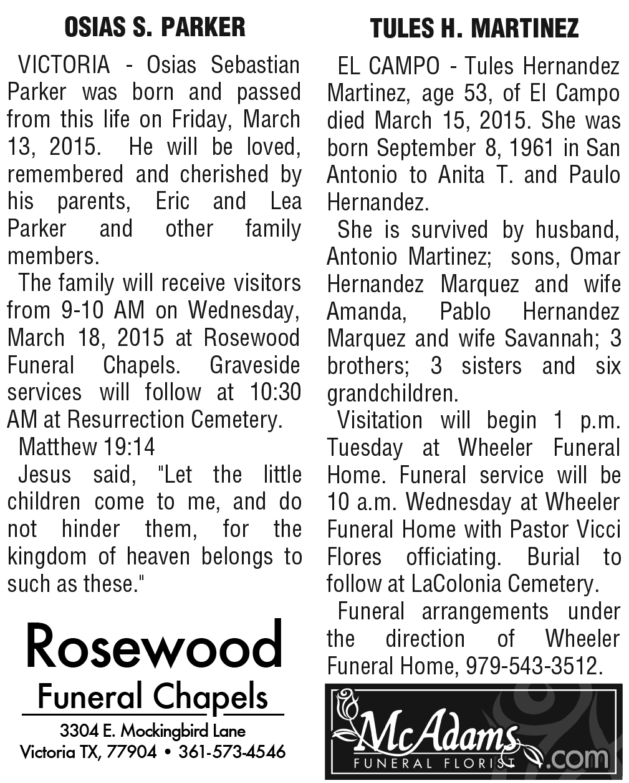
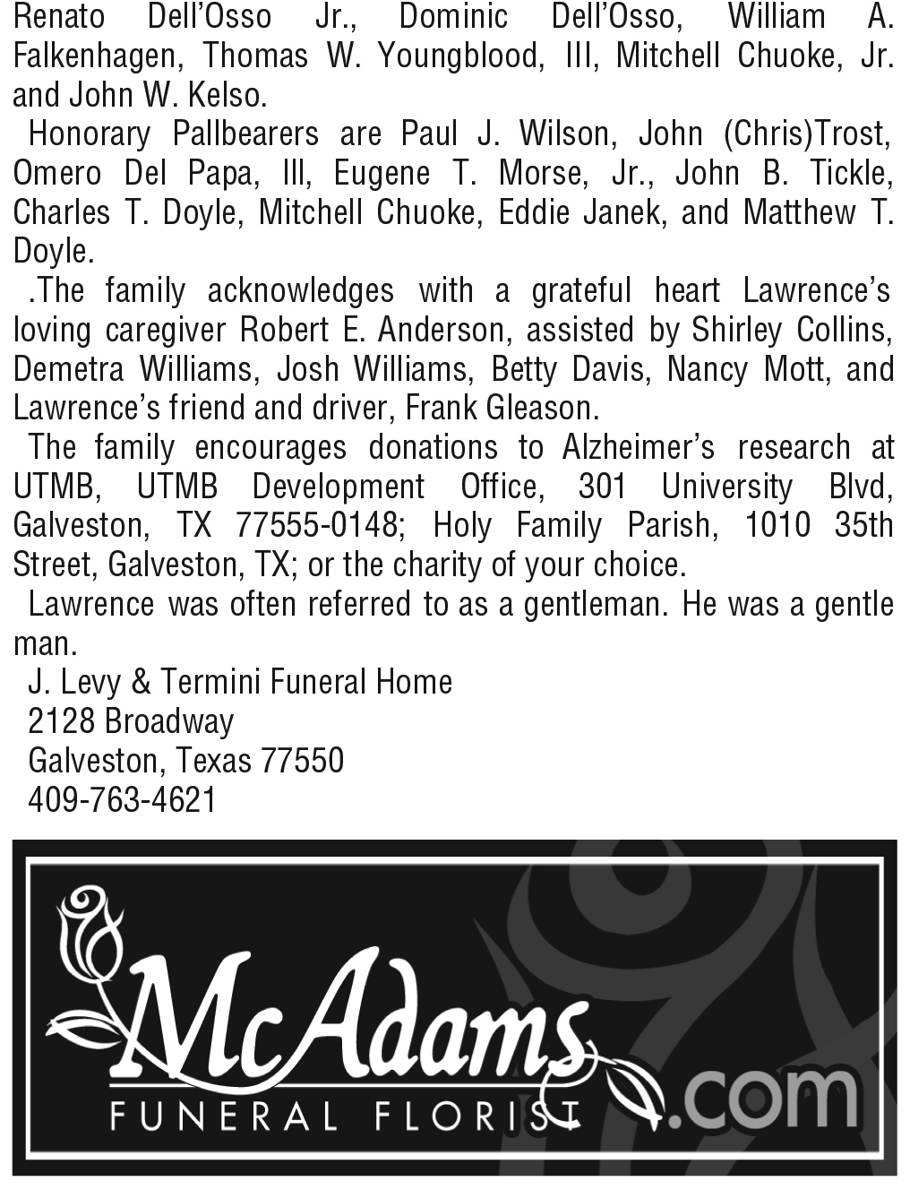
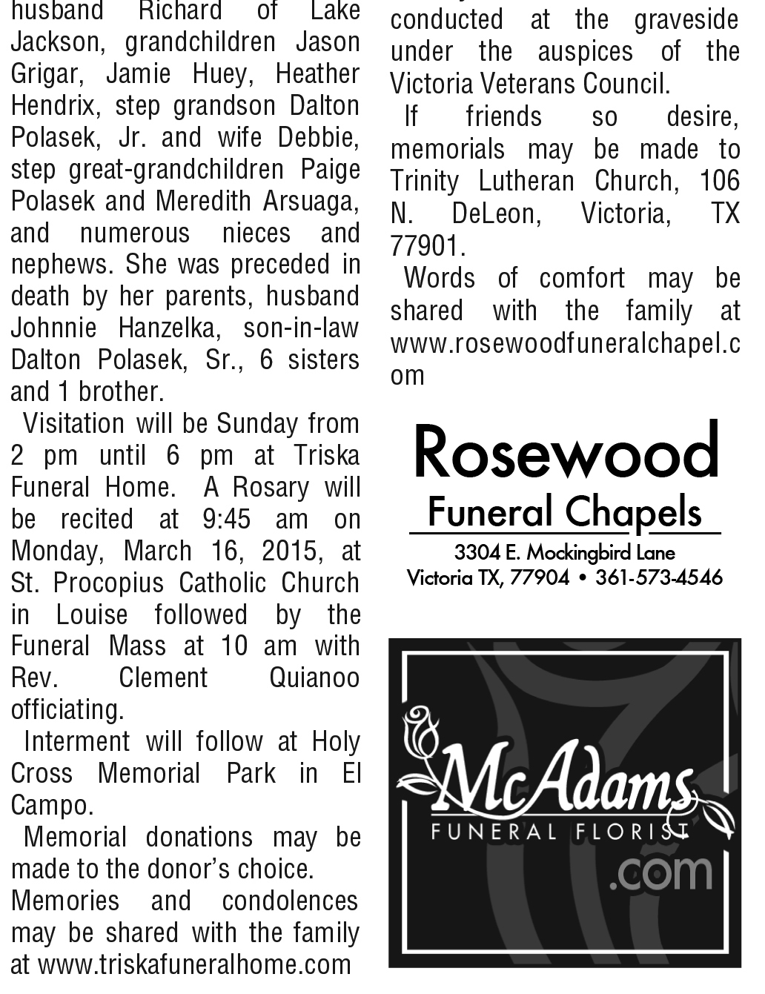
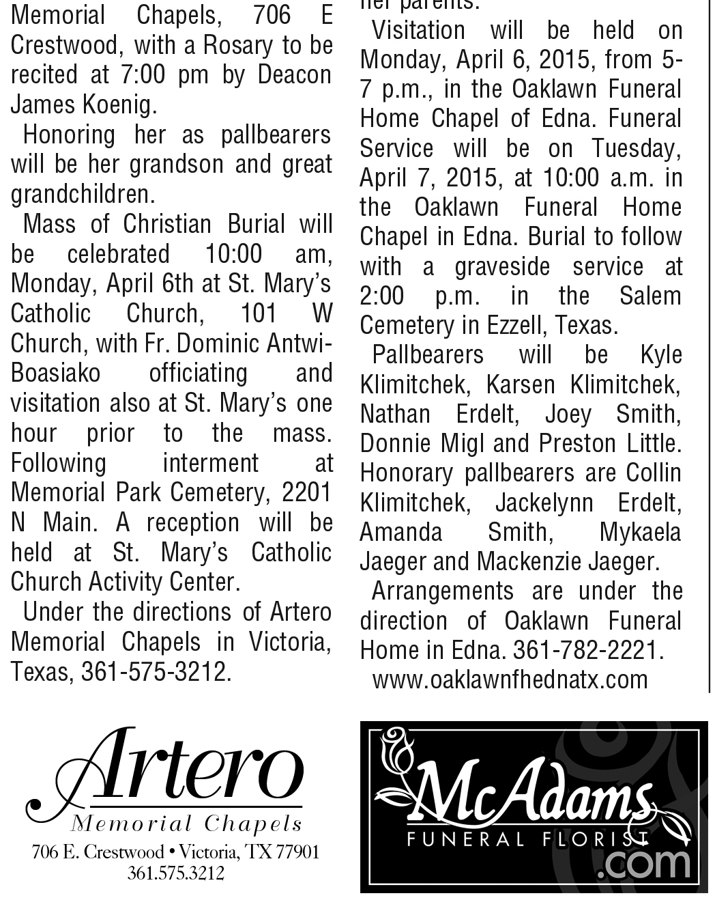
Cost Savings on Newspaper Page “Remnant” Space Ads
All newspapers are working on incorporating “late request” obituaries as their final task before going to print.
When the reconfiguration is complete, they often have left over “remnant” space, because of the obituary counts and lengths.
There are cost savings in negotiating a deal to advertise funeral florist “branding” ads in this remnant space, generally at one-third the standard rate.
Original content by McAdams Floral, Inc. Please do not distribute without permission.

Slide 19
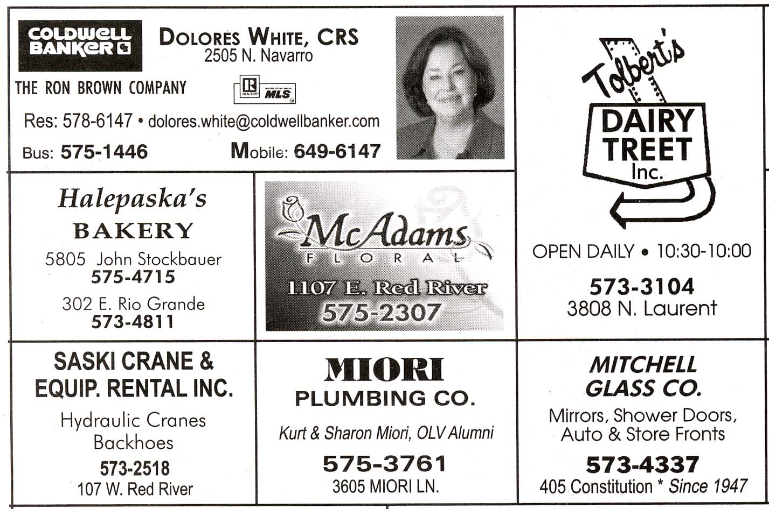
Church Bulletin Advertising
Church parishioners can be very loyal customers when they see you are supporting their bulletin with an ad.
SanFranciscoFuneralFlowers.com swears by this advertising, with bulletin ads in ALL area churches.
Original content by McAdams Floral, Inc. Please do not distribute without permission.

Slide 20



Online Obit Banner Advertising
Banners offer top-of-mind (TOMA)
branding as THE funeral florist.
Banners also provide hyperlinks for
online ordering.
Online media is growing while print
media is shrinking.
The obituary pages of the online version
of a newspaper consistently have the
highest number of page views.
Former area residents in their “golden years” who are now living elsewhere commonly scan obituary pages to check on past friends/neighbors.
Negotiate a trial period of 3 months or less, to see if it is a good fit for your firm.
Original content by McAdams Floral, Inc. Please do not distribute without permission.

Slide 21
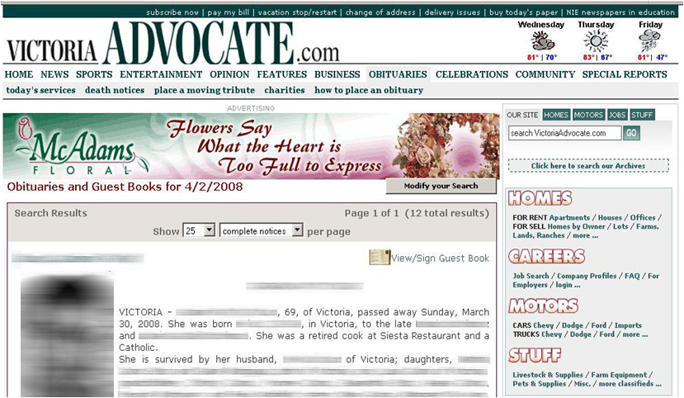
Online Obit Header Banner (Legacy)
Original content by McAdams Floral, Inc. Please do not distribute without permission.

Slide 22
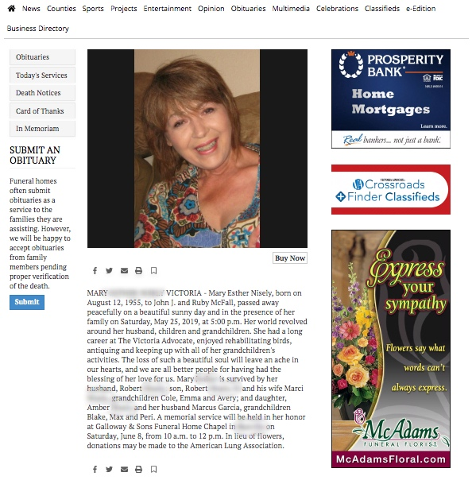
Online Obit Banner Ad (Current)
Newspapers use different online obituary website platforms, and platform companies or platform layouts can change over the years
Online advertising is generally based on “Views” and “Size”. Depending on the market, online rates can be highly negotiable.
Original content by McAdams Floral, Inc. Please do not distribute without permission.

Slide 23

Radio Advertising
Continue your firm’s branding as THE funeral florist.
Radio advertising can be powerful, when done properly with professional voice talent.
Radio stations often offer “fire sale” rates, so be pro-active and ask.
Radio stations have give-a-ways for Bosses/Secretaries Week and Christmas; suggest trading product for ad times.
Audio link – “Flower Garden”
Audio link – “Coach Sweeney”
Flower Garden – Sympathy Commercial
Young woman:
It was just a couple of days after my mom died, and my brothers and I were going through some of her things when, there was a knock at the door and it’s a delivery person with a bouquet of flowers, and the note said, “The thing I remember most about your mom was she was always out back in her flower garden”. You know, there was always a lot of life in this house. And there still is.
Man Announcer:
Flowers, the perfect way to honor a beautiful life. Call McAdams Floral today or visit www.mcadamsfloral.com. (Put 5 second jingle ending here).
Coach Sweeney – Sympathy Commercial
Young man:
My Grandma used to say that the best measure of a man’s life is how many friends he leaves behind. Well, Coach Sweeney passed away and you should have seen the how many people turned out for the funeral. And the flowers. There’s some sent from the school, from the Auxiliary. I mean the place looked like a float for the Rose Bowl Parade. You could tell. The man had friends.
Lady Announcer:
For the times in life for which there are no words, send flowers. Call McAdams Floral today or visit www.mcadamsfloral.com. (Put 5 second jingle ending here).
Original content by McAdams Floral, Inc. Please do not distribute without permission.

Slide 24
Television Advertising
Continue the branding theme: your firm is THE funeral florist.
Visual media is the best for showcasing our products.
Consider bartering floral products in return for TV advertising time.
To date, we have not produced a McAdams Funeral Florist TV ad.
Original content by McAdams Floral, Inc. Please do not distribute without permission.

Slide 25
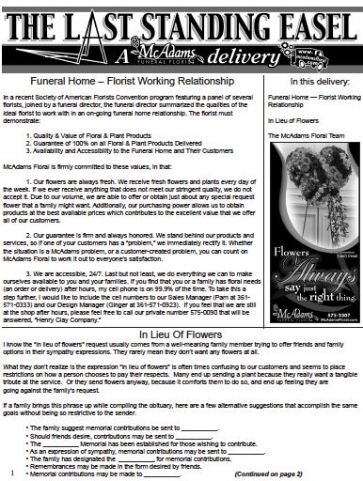
Funeral Home Newsletters
Send to funeral homes to keep your firm in front of funeral directors and their staff.
Use the opportunity to showcase (and boast about) your designers’ styles.
Highlight a referral that you received from a member of a family they served.
Discuss the use of “in lieu of flowers” and remind them of the alternative phrases which can be used in obits.
Original content by McAdams Floral, Inc. Please do not distribute without permission.

Slide 26
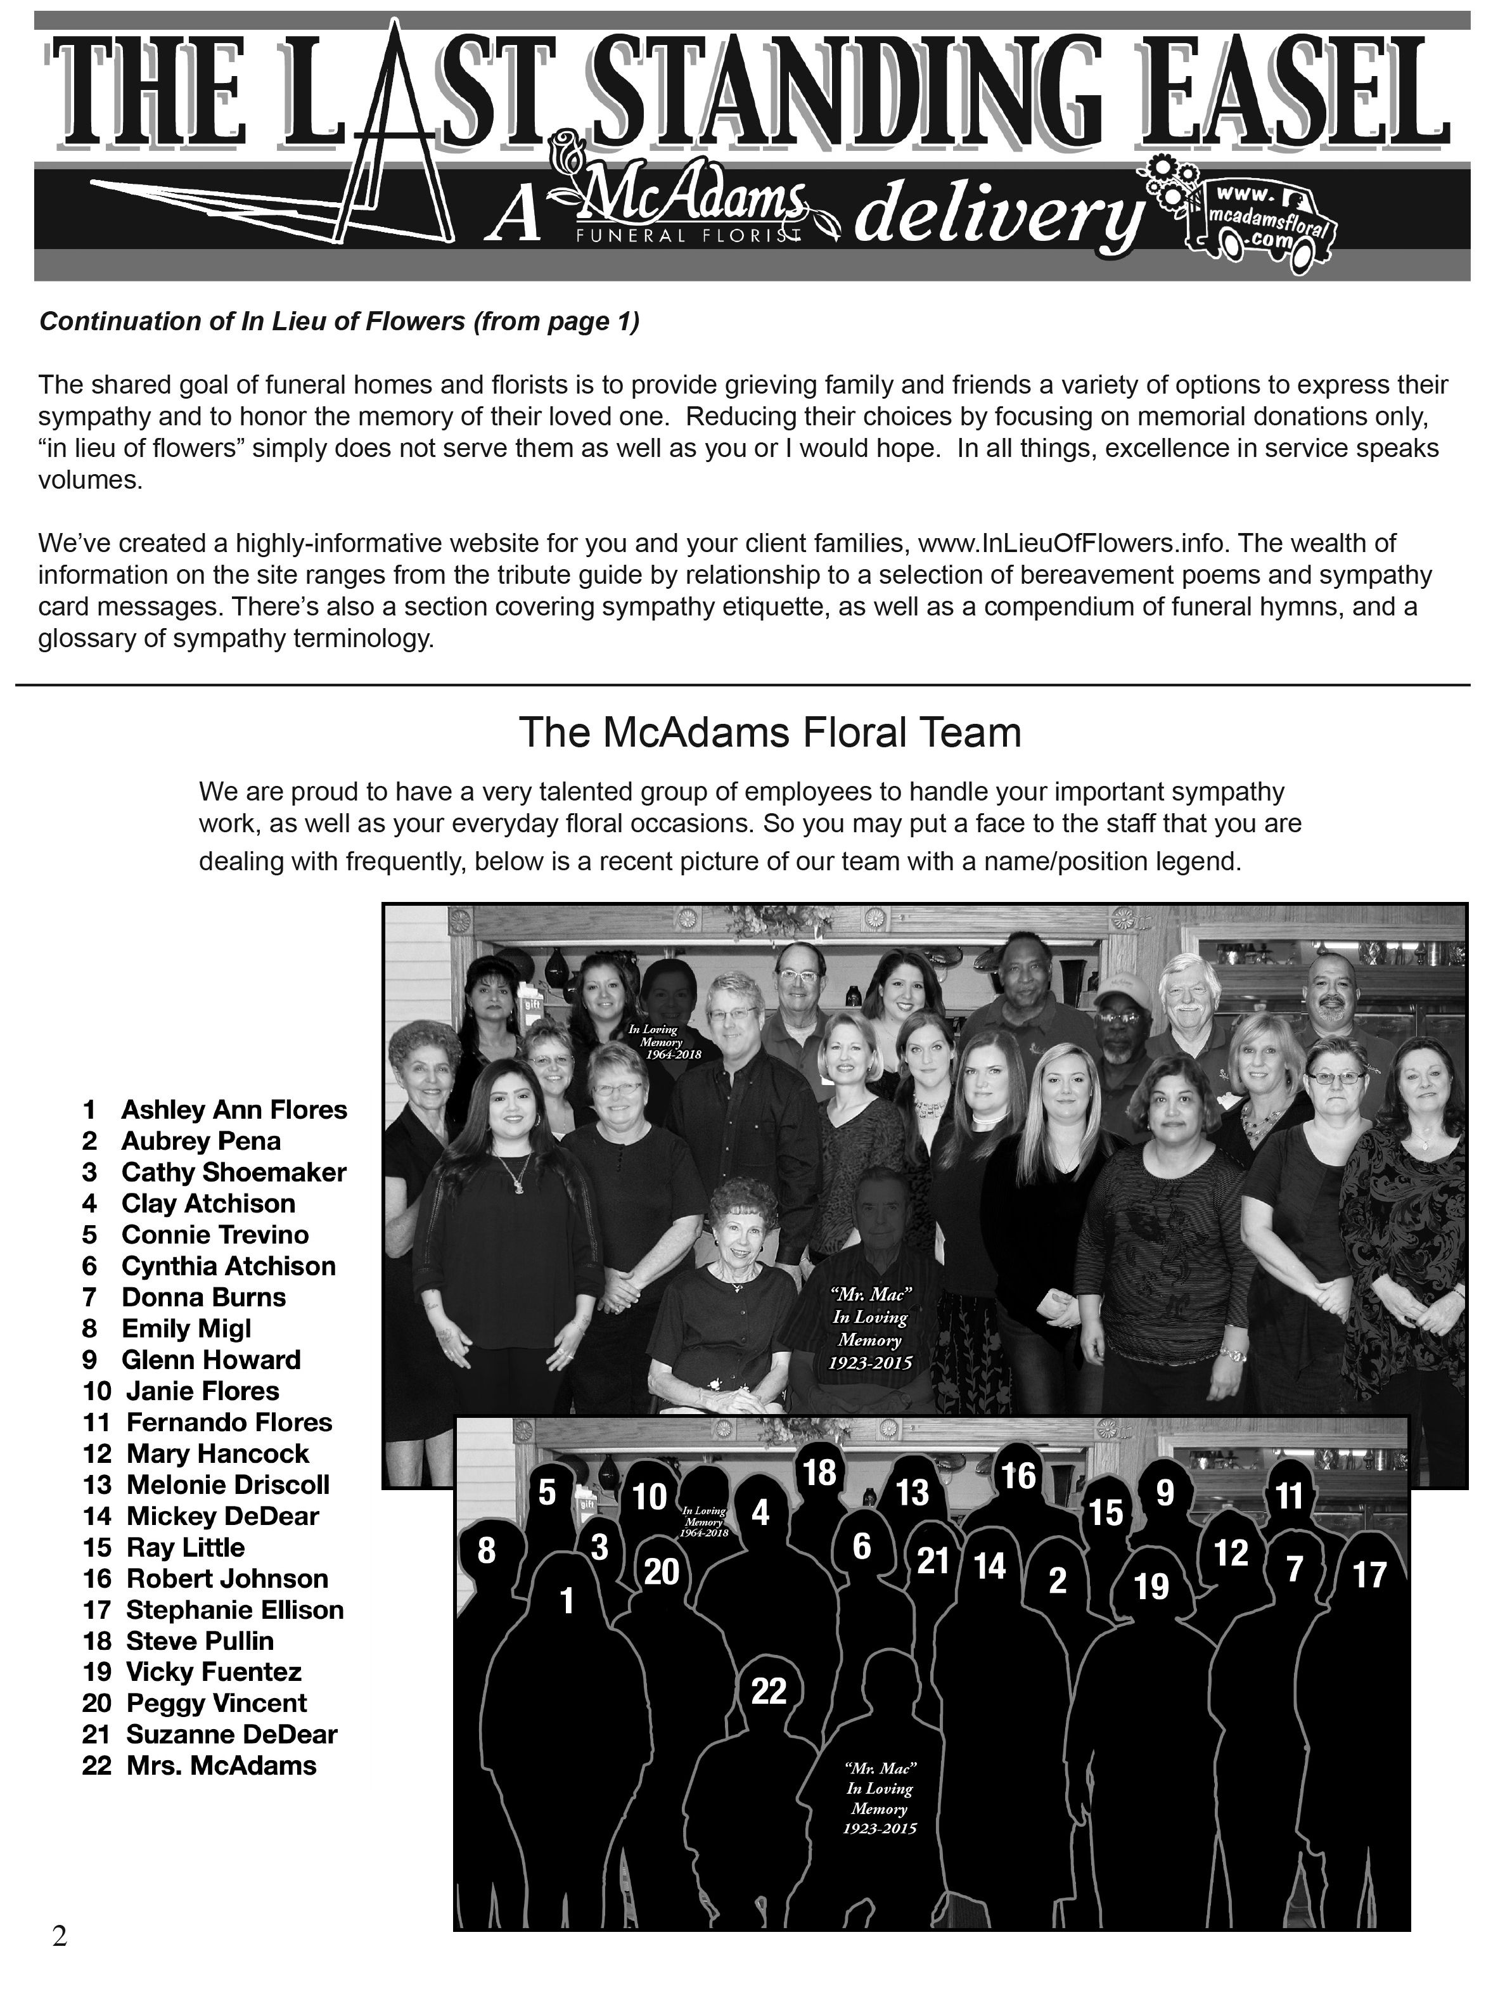
Funeral Home Newsletters
Send to funeral homes to keep your firm in front of funeral directors and their staff.
Use the opportunity to showcase (and boast about) your designers’ styles.
Highlight a referral that you received from a member of a family they served.
Discuss the use of “in lieu of flowers” and remind them of the alternative phrases which can be used in obits.
Original content by McAdams Floral, Inc. Please do not distribute without permission.

Slide 27
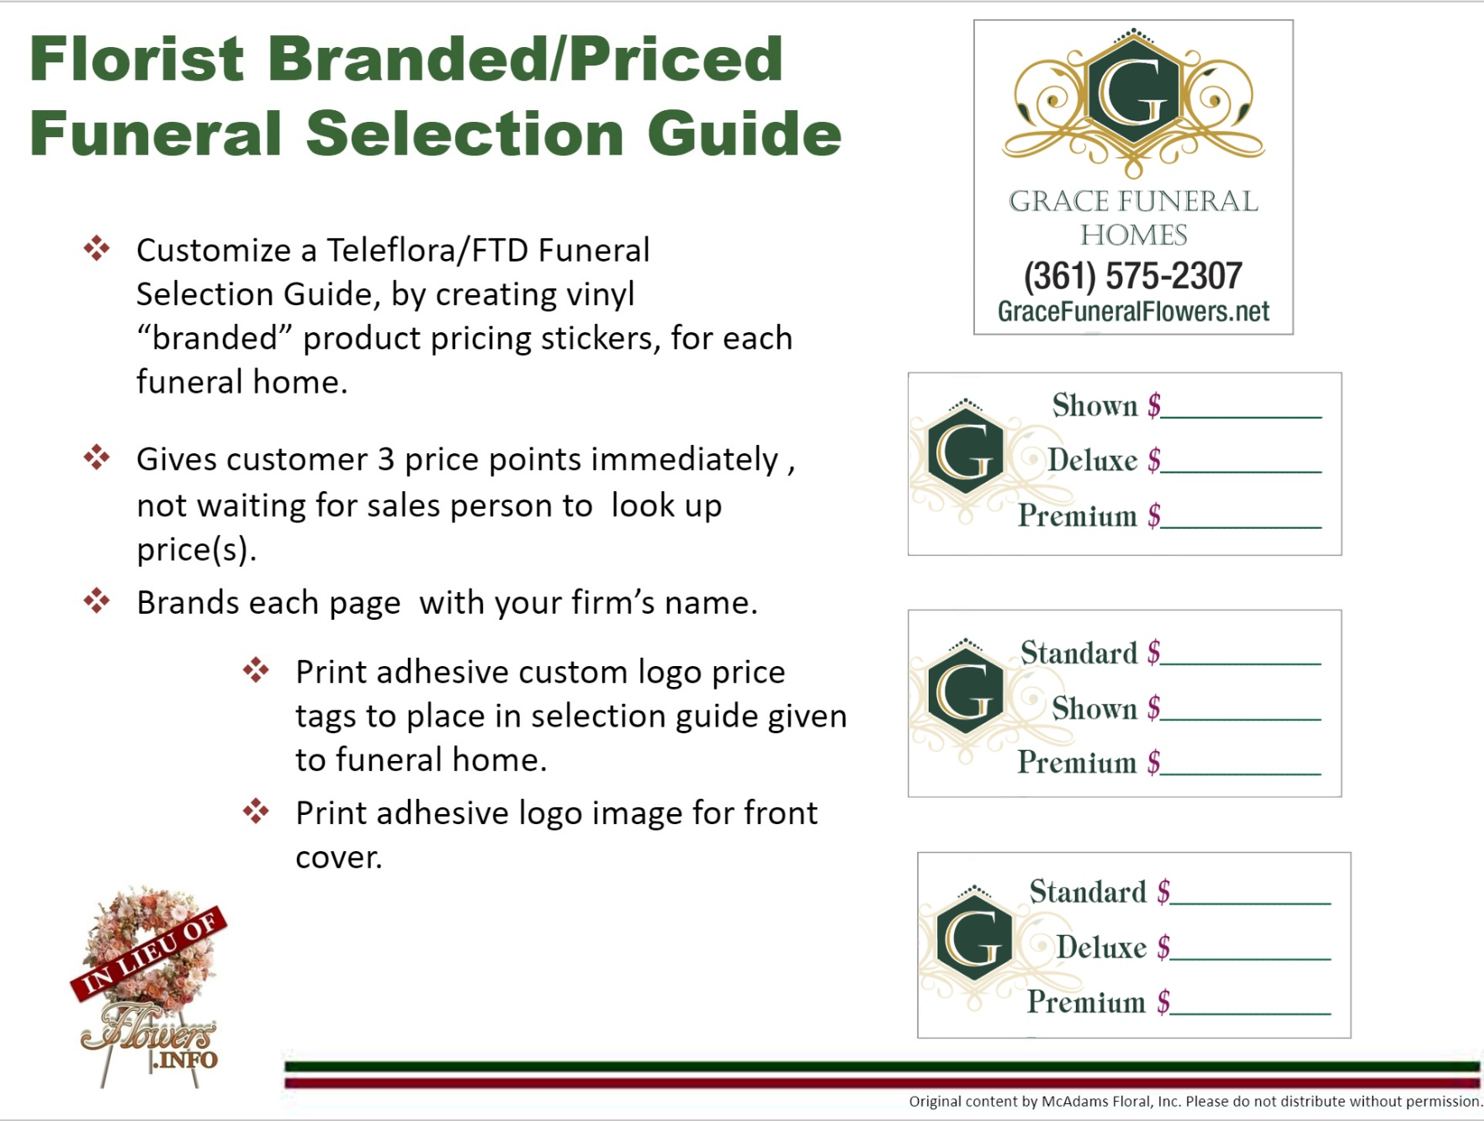
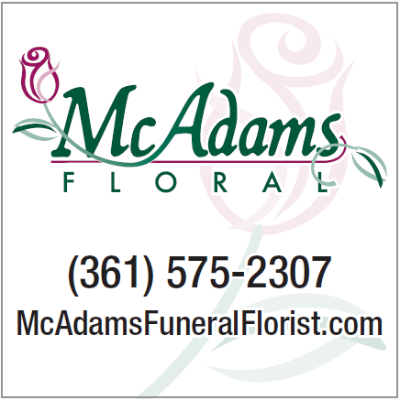



Florist Branded/Priced
Funeral Selection Guide
Customize a Teleflora/FTD Funeral Selection Guide, by creating vinyl “branded” product pricing stickers, for each funeral home.
Gives customer 3 price points immediately , not waiting for sales person to look up price(s).
Brands each page with your firm’s name.
Print adhesive custom logo price
tags to place in selection guide given to funeral home.
Print adhesive logo image for front cover.
Original content by McAdams Floral, Inc. Please do not distribute without permission.

Slide 28
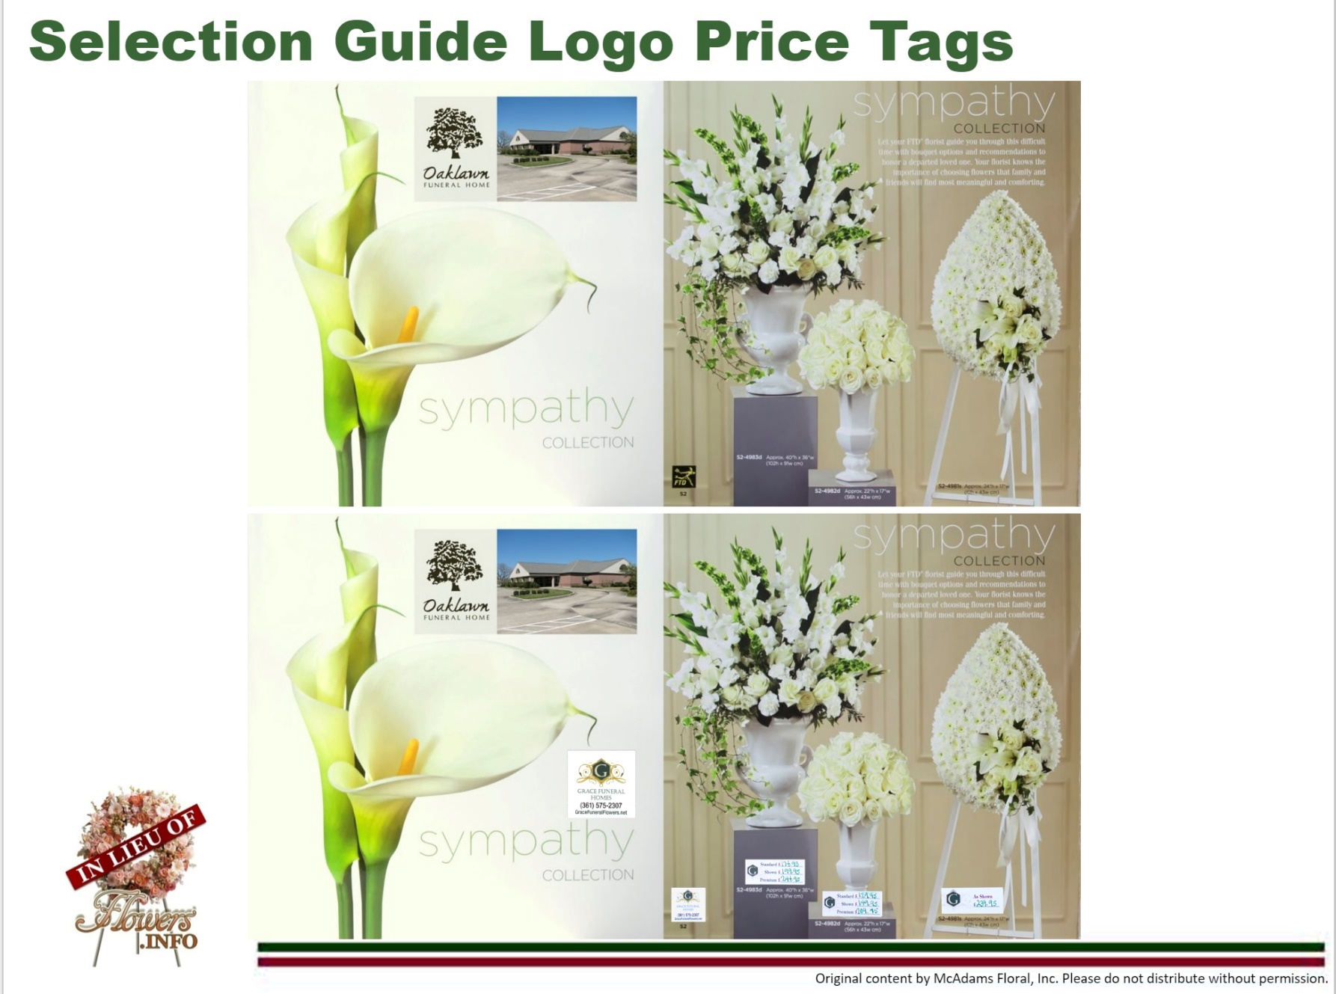
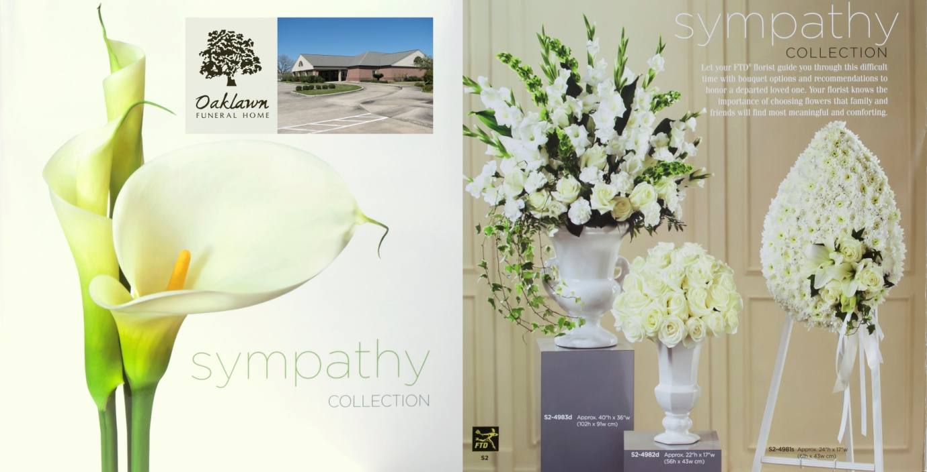
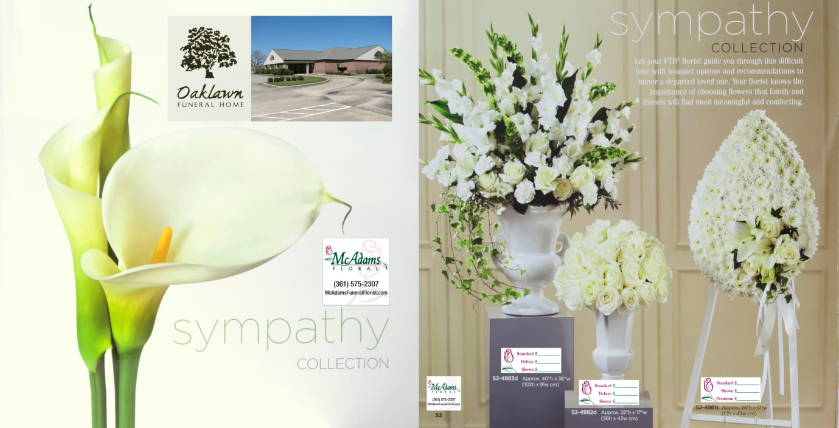
Selection Guide Logo Price Tags
Original content by McAdams Floral, Inc. Please do not distribute without permission.

Slide 29
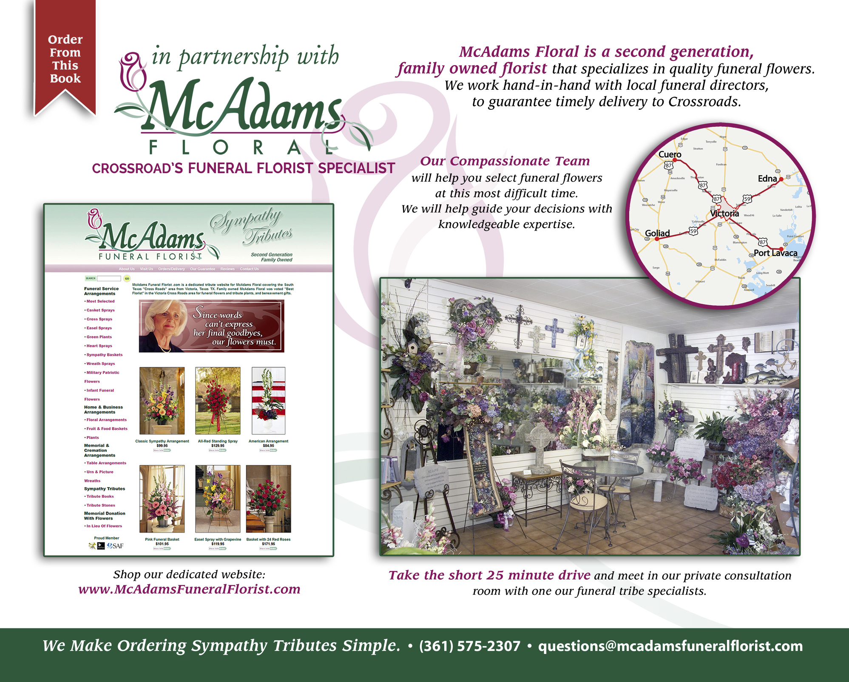
Fully Customized Funeral Selection Guide by TeamFloral and BloomNet
Give out custom price and branded Funeral Selection Guides to funeral home in delivery area communities and towns that have local florists.
About Us page promotes shop as the area funeral florist, and a purchase can be by a dedicated website or a short drive to the area funeral florist.
Original content by McAdams Floral, Inc. Please do not distribute without permission.

Slide 30
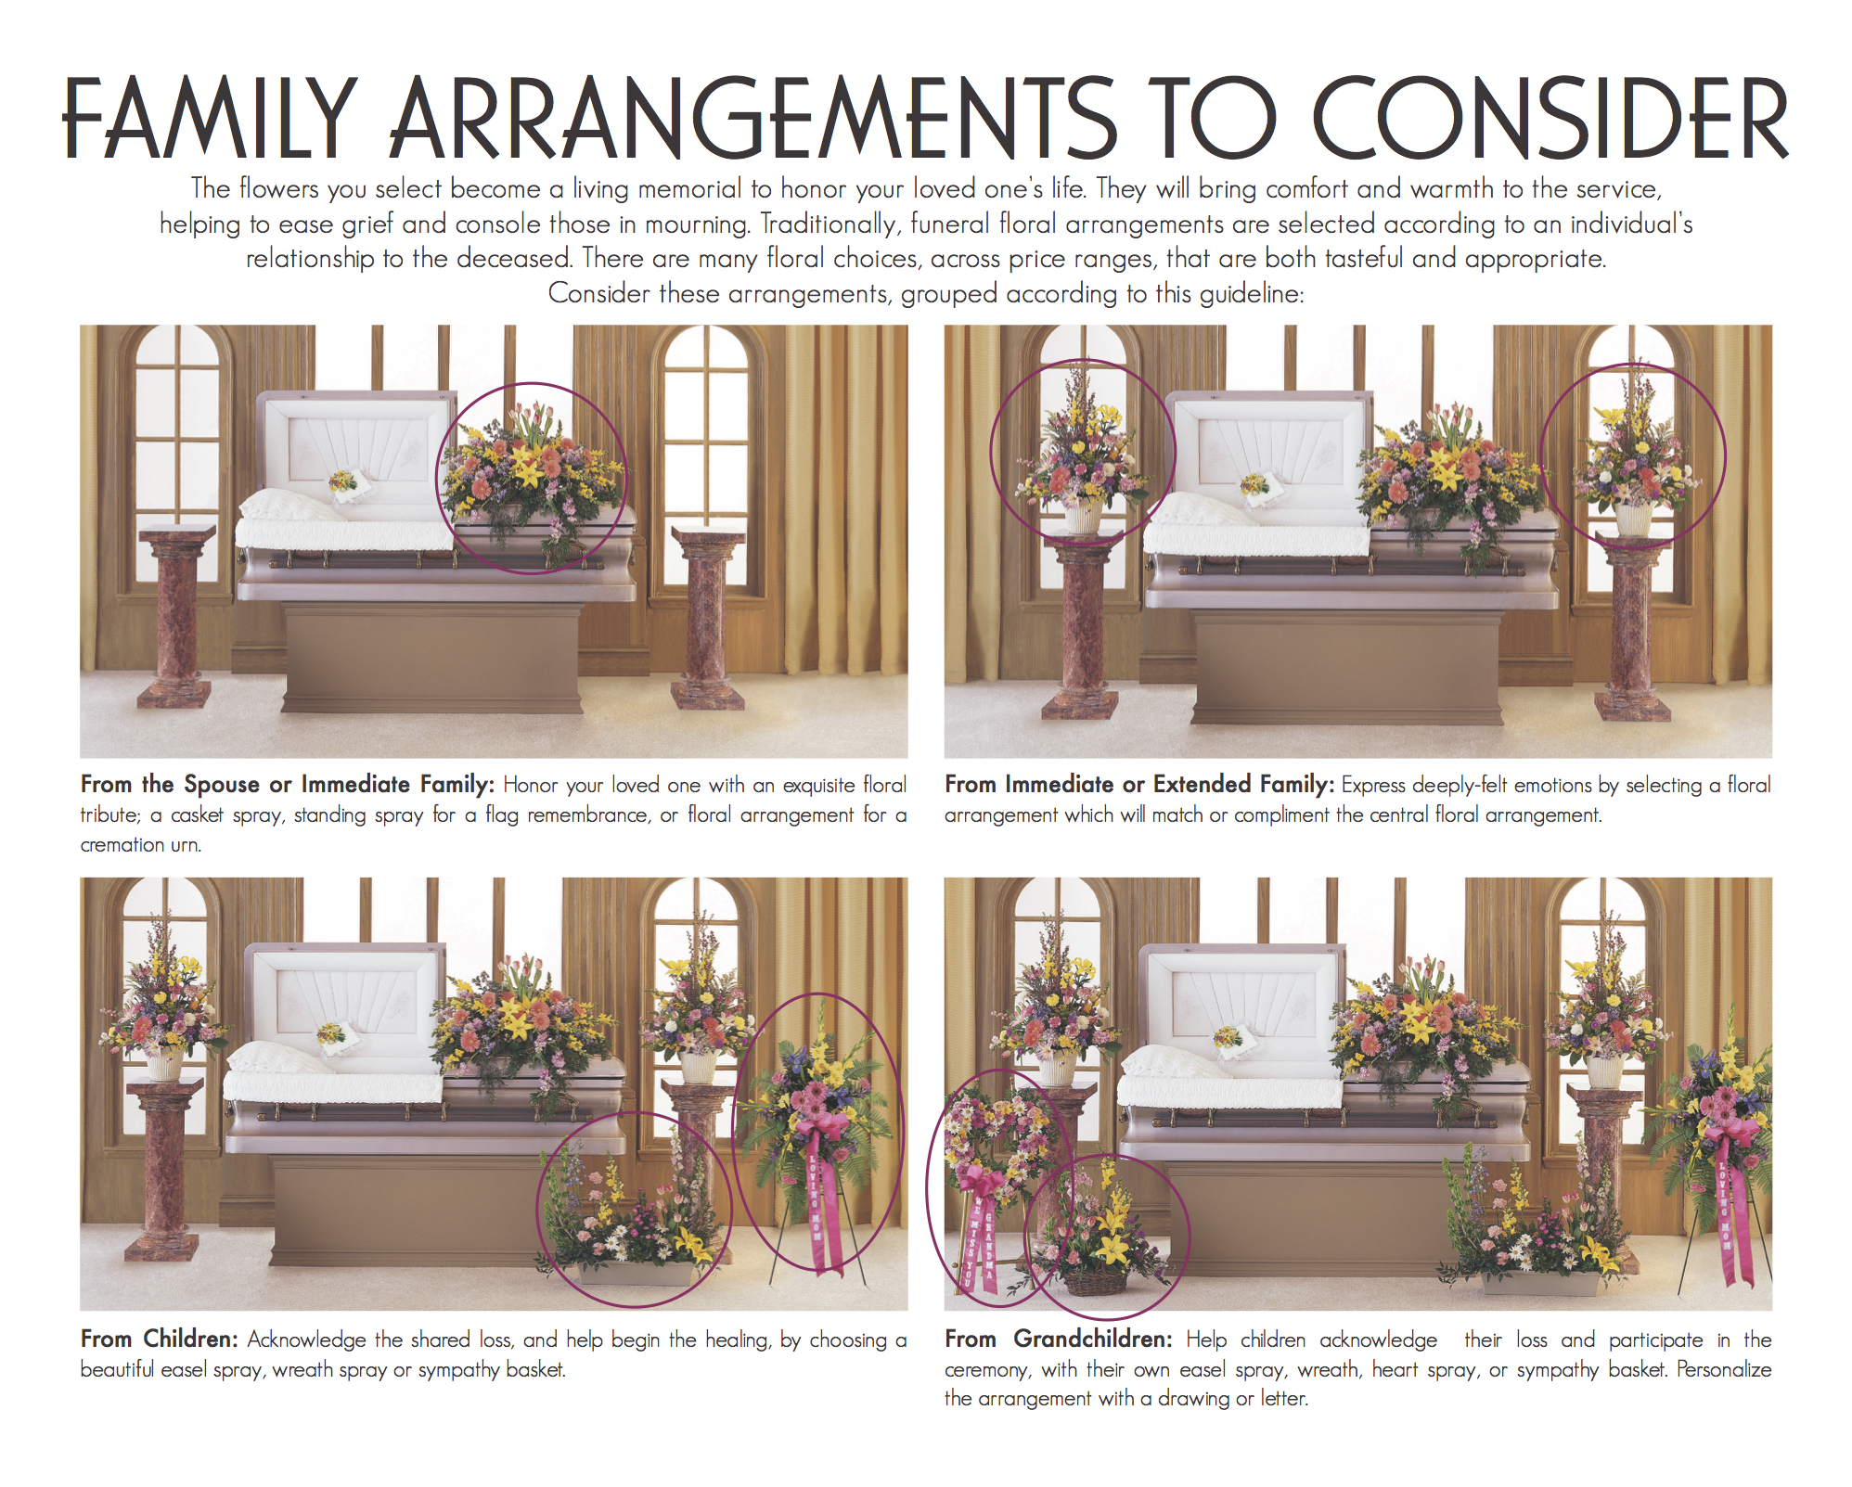
Fully Customized Funeral Selection Guide by TeamFloral and BloomNet
Paged added to Funeral Selection Guide, visually educates and promotes all the different family arrangement options.
Original content by McAdams Floral, Inc. Please do not distribute without permission.

Slide 31
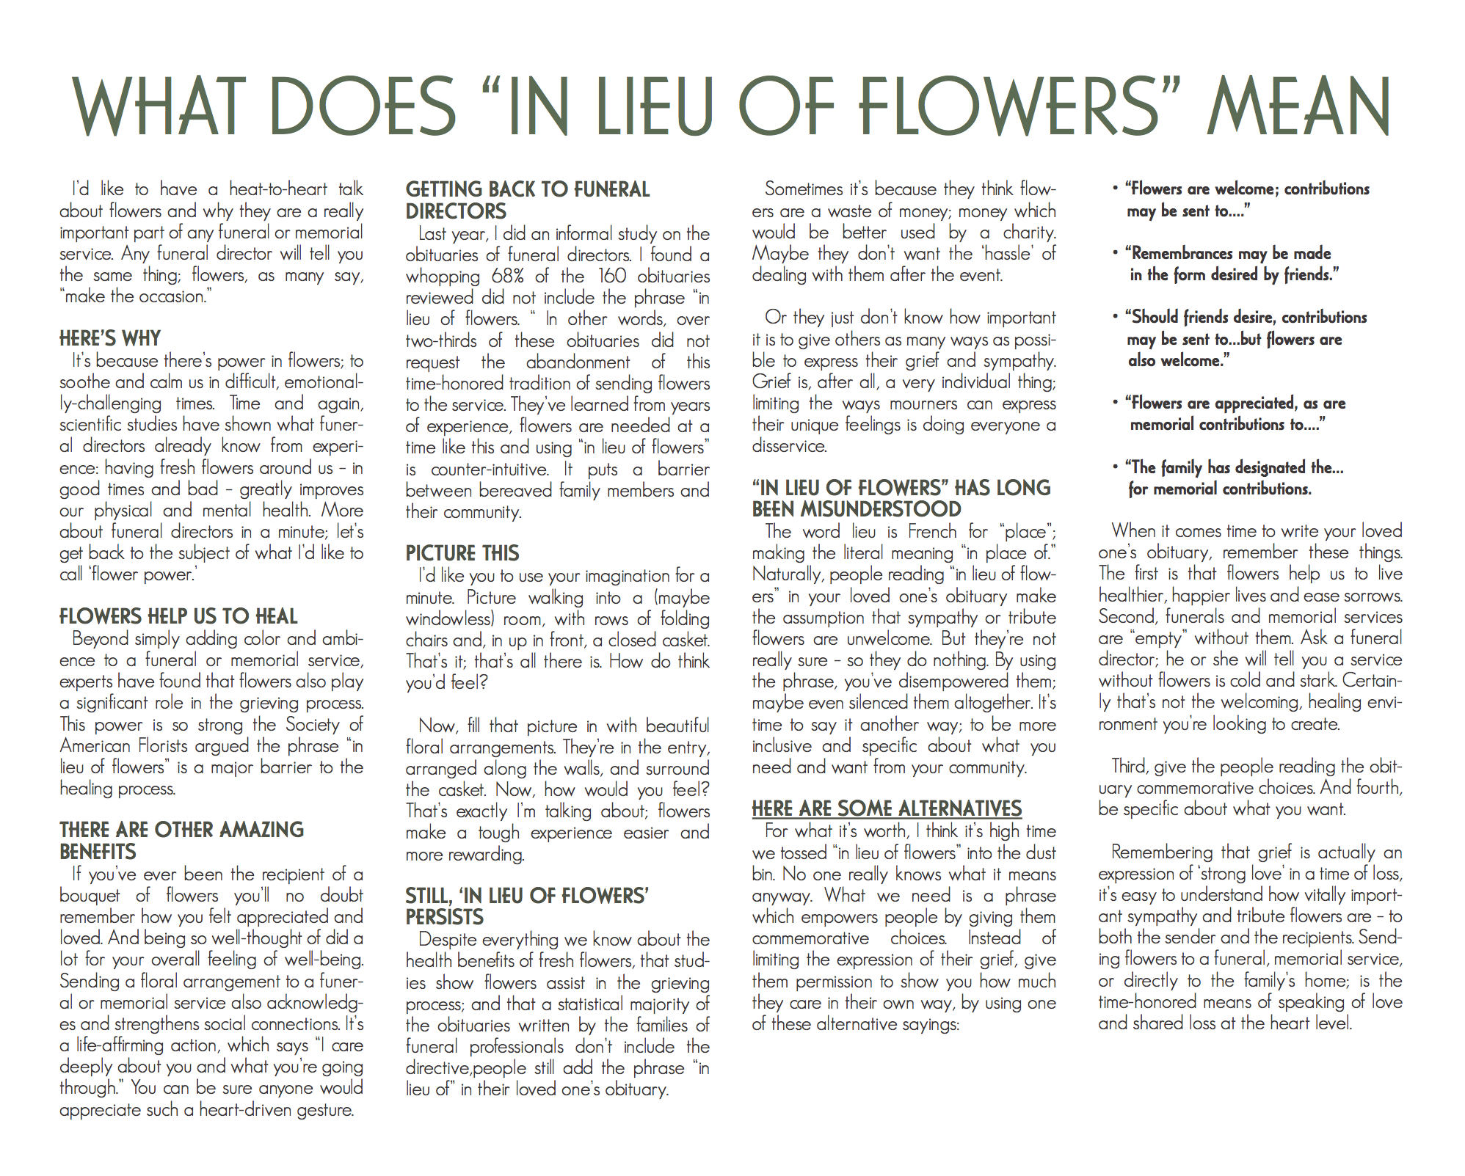
Fully Customized Funeral Selection Guide by TeamFloral and BloomNet
BEFORE THE IMMEDIATE FAMILY HAS WRITTEN THE OBITUARY;
Inform the family members and friends, the real benefits of flowers and plants at a funeral service
Educate about “In Lieu Of Flowers”, and how it is often misunderstood, and provide alternate says to use in place of the phrase.
Original content by McAdams Floral, Inc. Please do not distribute without permission.

Slide 32
Design Value Marketing
Original content by McAdams Floral, Inc. Please do not distribute without permission.

Slide 33
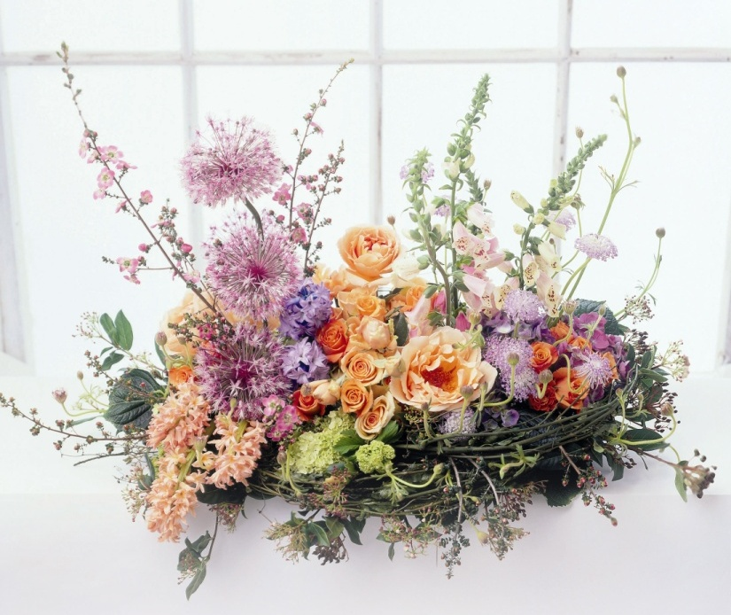
Offer Unique Designs
Use upgrade foliages like Ti leaves,
Lilly Grass, Eucalyptus, etc.
Layer flowers for depth & style.
Use low cost embellishments like butterflies, mushroom bird in the nest, ladybugs.
Design in a contemporary, freestyle way, not old-school oval/round with masses of Baby’s Breath.
Original content by McAdams Floral, Inc. Please do not distribute without permission.

Slide 34
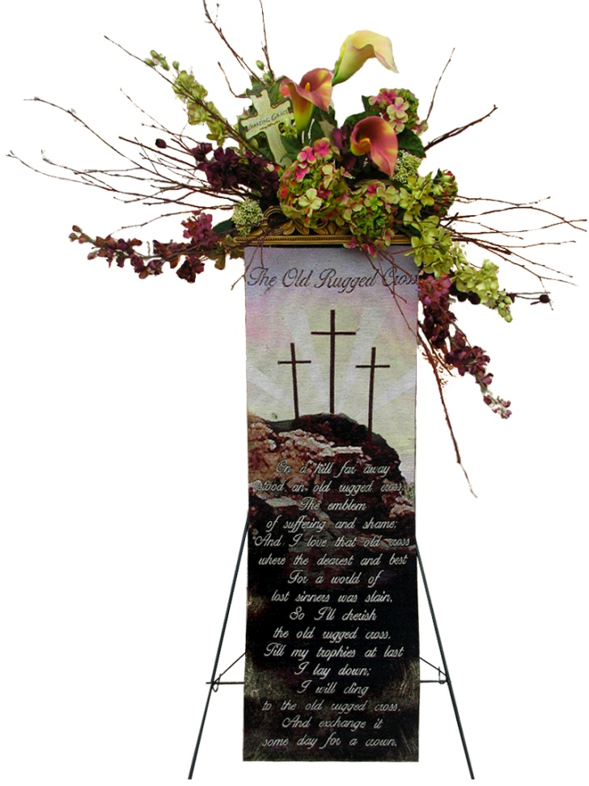
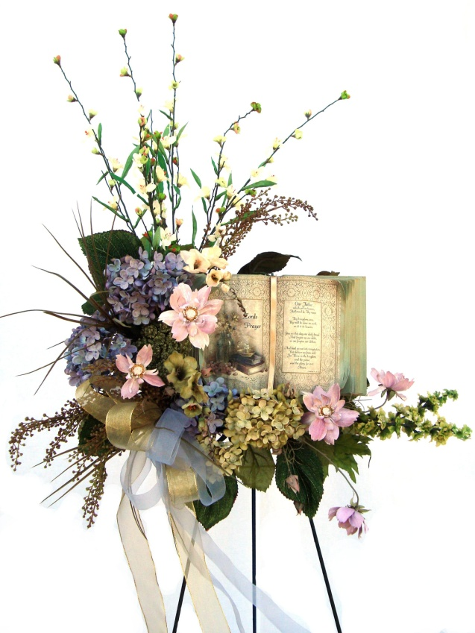
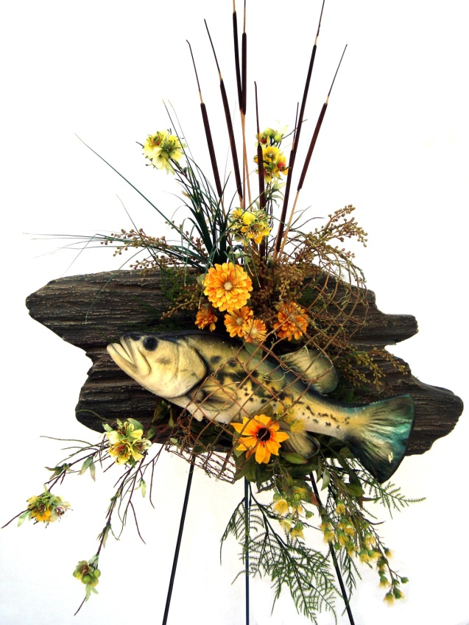
Offer Add-On Sales
Crosses, cherubs, tribute stones, picture frames, etc.
Woven sympathy afghans and wall hangings.
Faux fish, antlers, cowboy boots.
Original content by McAdams Floral, Inc. Please do not distribute without permission.

Slide 35
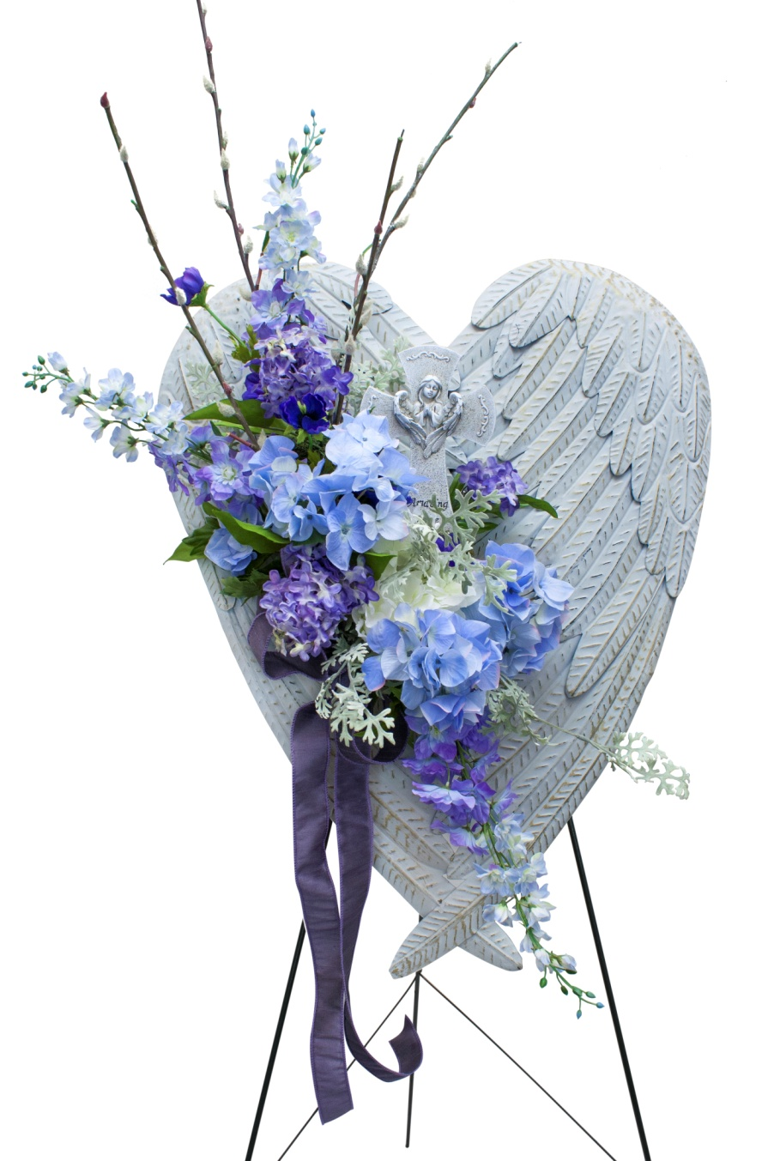
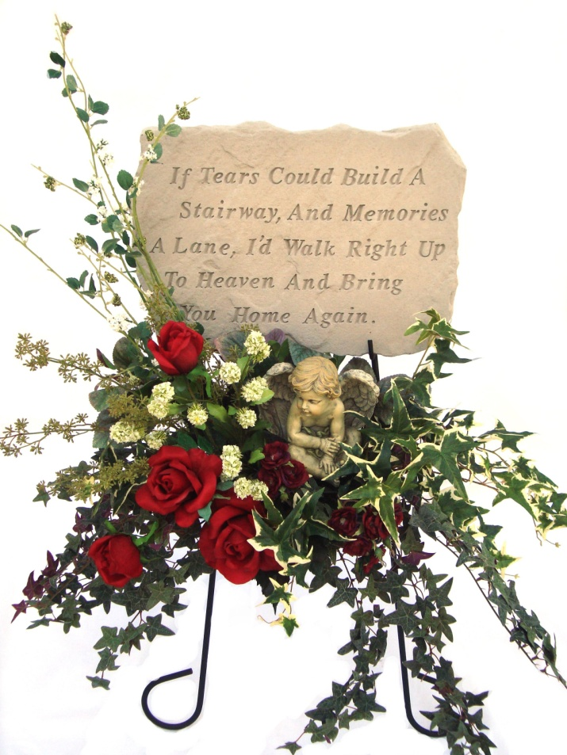
Offer Add On Sales
Custom Lettering on ribbon.
Embellishments to easel legs and baskets like curly willow, birch branches, reed, etc…
Original content by McAdams Floral, Inc. Please do not distribute without permission.
Notes:
Custom ribbon lettering
Easel leg embellishments
Baskets of curly willow, birch branches, reeds, or similar material

Slide 36
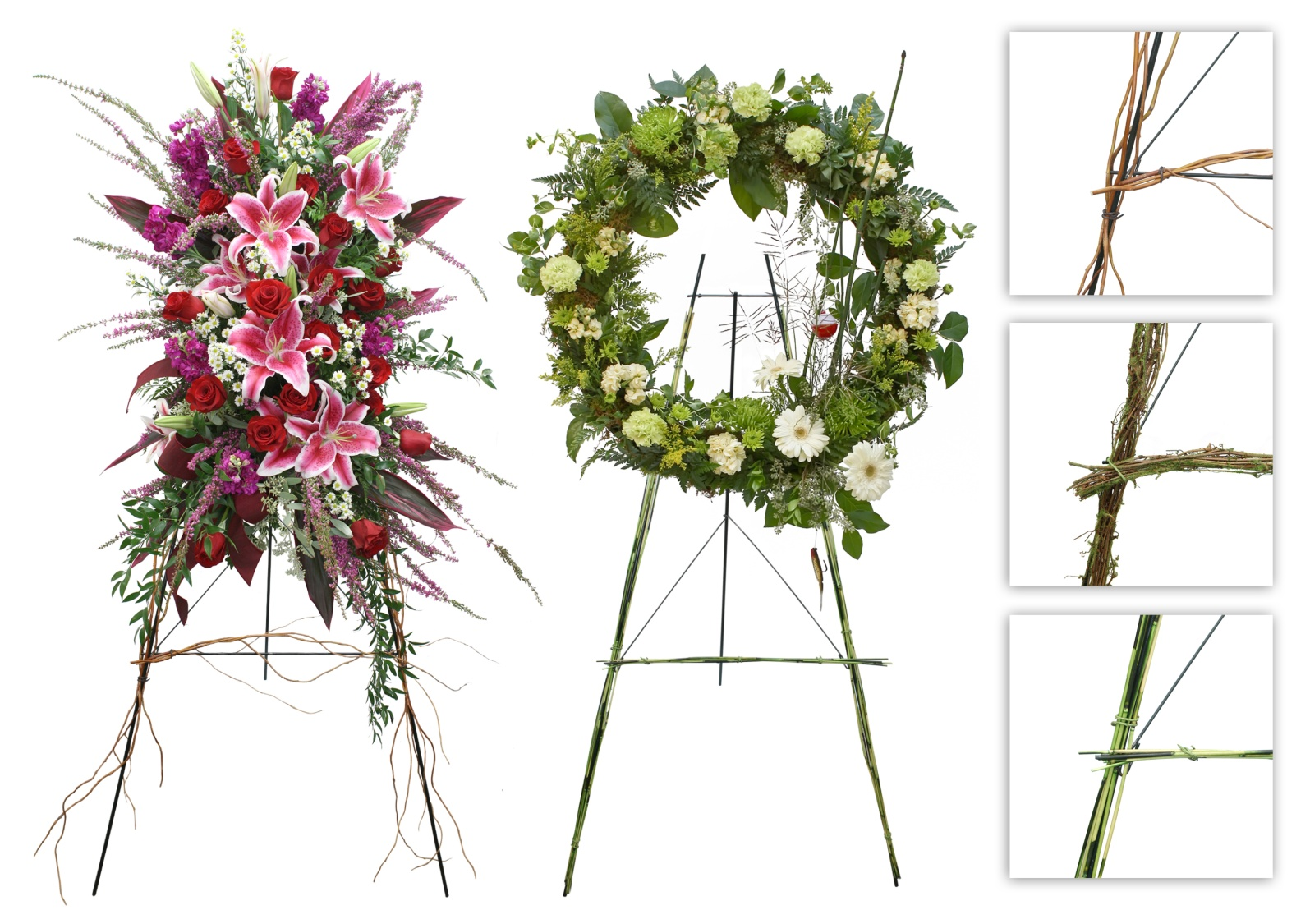
Easel & Container Value Enhancements
To create more value for the customer, offer enhancements to standard wire easels and basic containers.
Enhancements make your work stand out in a line-up of products from other flower shops.
Original content by McAdams Floral, Inc. Please do not distribute without permission.

Slide 37
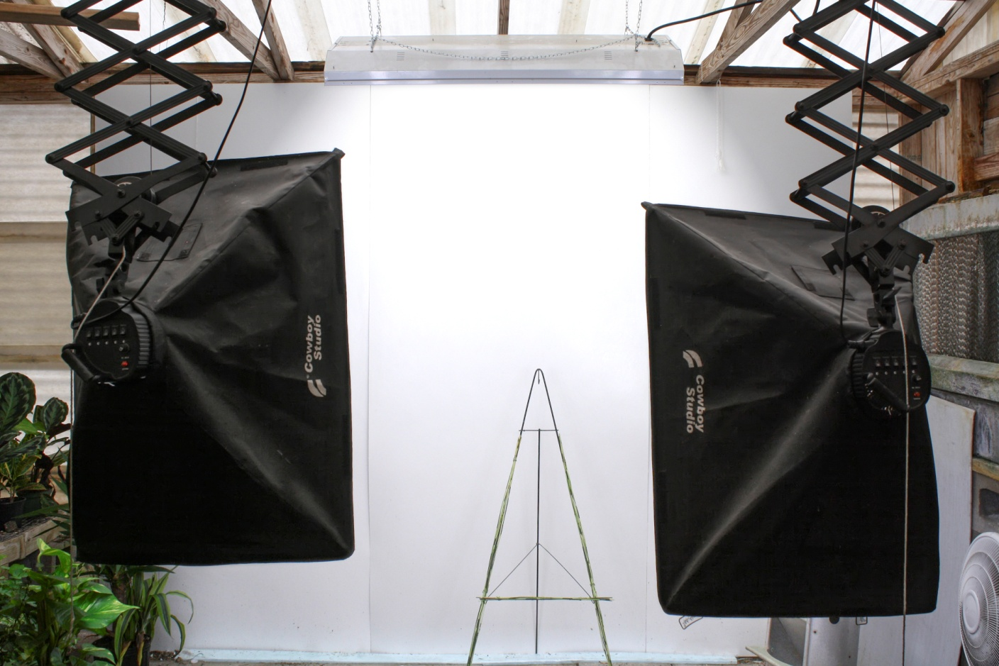
Offer Pictures of Your Own Designs
Provides a product offering to customers which is not available on your competitor’s “wire-service-image- only” websites.
Showcases your firm’s unique design style, which is more in tune with your customer demographics.
Original content by McAdams Floral, Inc. Please do not distribute without permission.

Slide 38
Sales Value Marketing
Original content by McAdams Floral, Inc. Please do not distribute without permission.

Slide 39
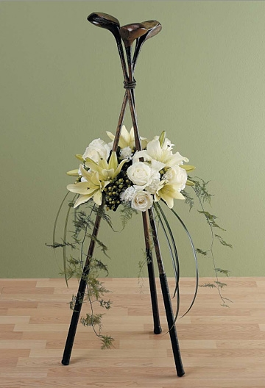
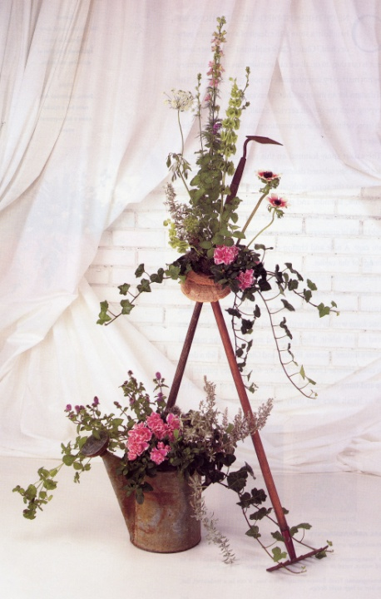
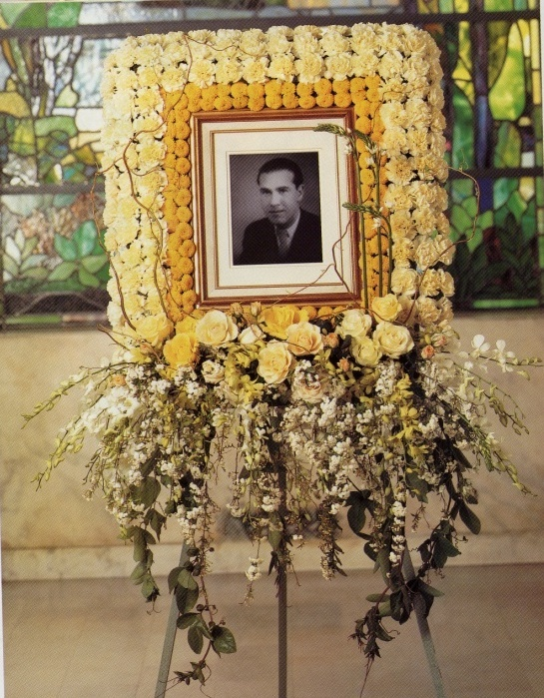
Funeral Tributes – Make Them Personal
Teach employees to ask questions about the deceased:
  What were their interests?
    Sports (football, baseball)
    Pleasures (golf, fishing, bridge)
  Were they an active member of any
  groups or organizations?
    High school class
    Rotary Club
    Army outfit
Original content by McAdams Floral, Inc. Please do not distribute without permission.

Slide 40
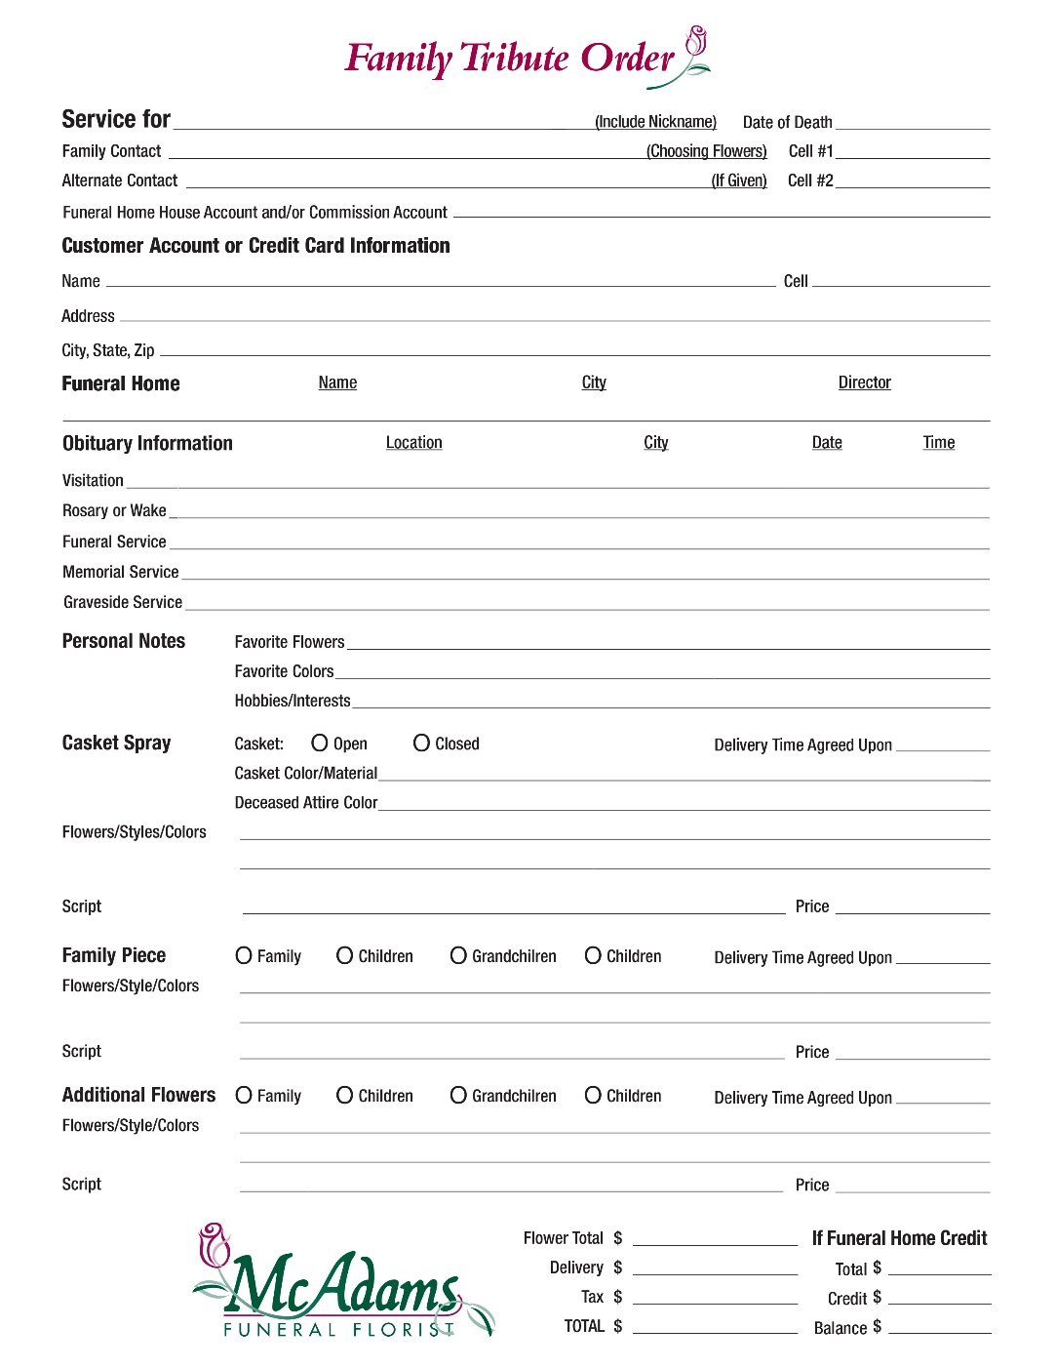
Family Order Form
Reminds all sales staff to ask:
  Dates & Times and Location, of Deceased’s Visitation/Rosary/Memorial/Funeral/Graveside.
  The deceased’s favorite flowers, colors, hobbies, and interests.
  Any special delivery requests in the “Time Promised” section.
Serves as a sales reminder for the other pieces from the children, grandchildren, and other family members.
Deceased Information to be entered on our funeral website obituary, before it is posted online.” Is to be added as the bottom item. The top first item will need to be forced up, to make room for all updates and this addition.
Original content by McAdams Floral, Inc. Please do not distribute without permission.

Slide 41
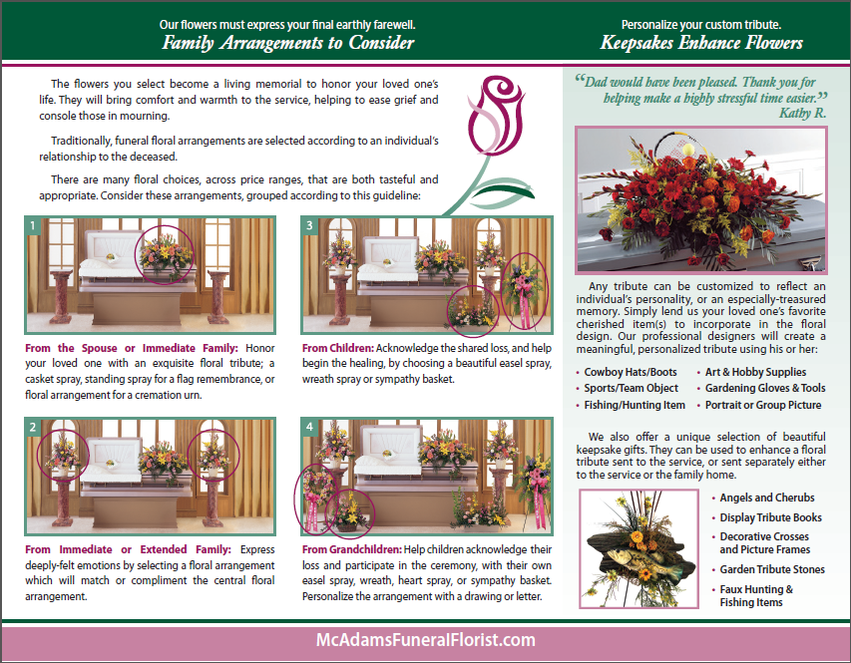
Inform Families About Multi-Family Pieces and Personalization
Immediate Family Marketing Tri-Fold Brochure – 1st Side
Original content by McAdams Floral, Inc. Please do not distribute without permission.

Slide 42

Inform Families About Multi-Family Pieces and Personalization
Immediate Family Marketing Tri-Fold Brochure – 2nd Side
Original content by McAdams Floral, Inc. Please do not distribute without permission.

Slide 43





Inform About Multi-Family Pieces & Personalization – Goals & Intentions
1. The image found on the front panel is intended to brand us as a funeral florist and give our sympathy clients confidence in their selection of McAdams Floral, the Funeral Florist, for their family tributes.
4. Turning the brochure over, the content of the panel, “Sharing the Burden of Grief”, is intended to demonstrate that “flowers are important” and list some alternative ways to say “In Lieu of Flowers”. This information is provided because of a relatively common scenario. The immediate family visits the florist after making their funeral arrangements, but before they write the obituary. During this visit, our brochure can effectively influence them to consider alternatives to “In Lieu of Flowers” in the content of the obituary.
2. Once the brochure is opened, you’ll see the “Family Arrangements to Consider” double panel . This is intended to inform immediate family members about the different traditional selections that could be made on behalf of each family member or generation. Our sales staff will provide a copy of the brochure to each family member present, giving them time to reflect quietly together. The staff member can also review/present this information to the family and answer any questions they may have.
5. The next panel, “Our Compassionate Team Will Help,” provides brief information on various ways that other family members can order floral/plant tributes. We inform them that we have a dedicated website with area obituary listing and our complete contact information. Family members and friends from out-of-town/state can easily access information and place their sympathy orders.
3. To the right of the double panel, another panel educates family members and promotes “personalizing the family tribute(s) for more special significance. This panel suggests a few of the deceased’s personal items, which can be brought in and added to the floral tribute(s). It also mentions keepsake items, which could complement a sympathy tributes and are available for purchase at our shop.
Original content by McAdams Floral, Inc. Please do not distribute without permission.

Slide 44

Staff Sales Sheet
The sales form helps staff offer the best “value match” to a customer’s requests and expectations.
Offering 3 price points assists in selling a “one size upgrade” to a customer’s initial request.
Original content by McAdams Floral, Inc. Please do not distribute without permission.

Slide 45

Funeral Design Supply Cost Accounting
The pricing form for funeral design “supplies & hard goods” helps to ensure the best value for your customer.
As it is too easy to overprice (guess) these costs, or worse, underprice or not include the cost at all, the form also ensures transactional value for your firm.
Original content by McAdams Floral, Inc. Please do not distribute without permission.

Slide 46

Salesroom “Value” Product Images
In our area, many people (especially the older generation) think they will get a “fabulous” casket spray for $200.
A tiered image of 4 casket sprays and the related price puts “value” into a visual perspective.
The image promotes a customer’s selection of a spray within the upper price ranges.
Original content by McAdams Floral, Inc. Please do not distribute without permission.

Slide 47

The Funeral Home Tribute Product Price Sheet
Original content by McAdams Floral, Inc. Please do not distribute without permission.

Slide 48

Digital Display Marketing
Large lower-resolution monitors are
inexpensive enough to make it
affordable to have continuous digital
display marketing on one wall of your
sympathy consultation room.
Compile a PowerPoint presentation
of visually-appealing content
promoting additional family pieces,
showcasing special or unique designs,
and displaying available add-on
products. Also add content which reinforces the many benefits of flower and plant tributes, and show the “alternatives” to “in lieu of flowers”.
When secluded in the sympathy room or dedicated area of your shop, these funeral customers become "a captive audience" and receptive to such digital messaging.
Original content by McAdams Floral, Inc. Please do not distribute without permission.

Slide 49

Church and Cemetery Offerings Brochure
Florists often
forget about offering
the family
of the deceased,
arrangements for the church
service, or
anniversary dates.
Original content by McAdams Floral, Inc. Please do not distribute without permission.

Slide 50

Church and Cemetery Offerings Brochure
Educated
the family about the different offerings for the cemetery grave site.
Original content by McAdams Floral, Inc. Please do not distribute without permission.

Slide 51
Florist-to-Funeral Home Relationship & Marketing
Original content by McAdams Floral, Inc. Please do not distribute without permission.

Slide 52

Funeral Home Availability & Accessibility
I showed this to a local funeral director, and he concurred: these three qualities were the exact ones he requires of his florists.
He also mentioned that item # 3 is almost more important than the other two for him.
.
Original content by McAdams Floral, Inc. Please do not distribute without permission.

Slide 53


Funeral Home Visits
After the Funeral Shop OWNER visits all of the funeral homes served, consider the employees visiting the funeral home when slow or schedule several days as employee visit days.
Groups of two preferably go over together to each funeral home, so the Funeral Homeowner/Manager be more willing to come out to meet, and possible give a 10-minute tour. The first set of employees takes flowers with them.
Employees that visit, to wear company Polo Shirt and name take. If they have business cards, hand out one to the person that is showing then around. Ask to get one of their business cards for each employee.
Employees to specifically ask to see each funeral home Visitation/Service rooms, to get an image of layout, size, and lighting…..to be able to know when talking to customers asking about specific layout/location questions.
After I gave my Sympathy Presentation at the 2009 TSFA Convention, afterwards Tom Butler came up to me to relay “nice job on the presentation and the material covered”. One tip that he suggested that I should have done at the very beginning of the Sympathy Presentation, was to “ask for a show of hands on how many has visited with their funeral directors in the last 6 months, 1 year, 2 years, and 5 years” and he said that “the show of hands would show what is the real problem with their sympathy business” (he said it better, I cannot remember his exact words).
Original content by McAdams Floral, Inc. Please do not distribute without permission.

Slide 54

Funeral Home Availability & Accessibility
All funeral directors should be given “before” and “after” hours phone numbers for your firm.
In fact, all funeral directors are given my home and cell phone numbers.
They are also given the cell phone numbers of my shop managers.
Funeral Directors do not abuse the privilege. When they call, generally it is to:
  Tell us of a sympathy product problem over at the funeral home (whether our fault or not), and we go fix it ASAP.
  Tell us of an upcoming VIP death, to alert me that I might need some extra flowers in stock.
  Give me an order, as they just finished meeting with the immediate family.
  Give me heads up that they will need some assistance on moving flowers the next day, as their flower van will be at another service at the same time.
Original content by McAdams Floral, Inc. Please do not distribute without permission.

Slide 55

Funeral Home Phone Referrals
Funeral homes get a lot of calls asking for a name of a florist. Know which florist they are recommending by placing test calls.
If all phone employees are giving your shop name except one, consider discussing this with the funeral home owner.
Also test call after hours to see what florists the answering services are recommending.
Original content by McAdams Floral, Inc. Please do not distribute without permission.

Slide 56

Funeral Home Third-Party Website Flowers
Most third-party websites for funeral homes have flower links to order-gatherers or directly to a wire service to facilitate the order.
Local florists get the order at 73% of the retail value, and most likely at an under-valued price before the discount.
The facilitating company can over-promise the customer, and the florist filler is held responsible, if only by association.
Original content by McAdams Floral, Inc. Please do not distribute without permission.

Slide 57

Propose a Direct Flower Link Deal
Use the information in this SAF Floral Management article as a means to explain how the funeral home's third-party website flower link works, and how it is actually detrimental to all concerned.
Then review in as much detail as possible the positive benefits of a direct link to your shop/website.
Make the pitch! You have nothing to lose, and a lot to gain.
Original content by McAdams Floral, Inc. Please do not distribute without permission.

Slide 58

Grow Your Business: Offer Commission-Based Funeral Flower Websites
You can establish the relationship before–or after–a local funeral home has made a deal with an industry-based website provider.
Because of your locality and high-level of personal service, your flower direct deals will stand “head and shoulders” above those available from order gatherers or the wire service direct.
Your commission deal could be 10-15%, versus the 27% total value sacrifice with the current arrangement they have with the website provider.
A Funeral Flower website provided by you, means that the flower arrangements and plants are priced at full value.
A dedicated funeral flower website will help commit a funeral home’s loyalty to your business.
Original content by McAdams Floral, Inc. Please do not distribute without permission.

Slide 59

Develop a Partnership Program
Is a proactive way to solicit work from a funeral home before another florist offers them a “deal.”
Allows you to set a reasonable referral fee.
Gets them hooked on the quality of your work and service, before they get a higher referral fee from a competitor.
Original content by McAdams Floral, Inc. Please do not distribute without permission.

Slide 60

Partnership Program
The program does not cover funeral home referrals given out over the phone.
The program can generate additional orders, as the immediate family will refer both in-town and out-of-town family and friends to the florist making the “family tribute”.
Original content by McAdams Floral, Inc. Please do not distribute without permission.

Slide 61

Partnership Follow-up Letter
Send a letter following up on the initial partnership meeting held with the funeral director or owner of the firm.
Reinforce the particulars of the referral fee “deal” struck during the meeting.
Consider sending the letter along with a unique floral arrangement.
Original content by McAdams Floral, Inc. Please do not distribute without permission.

Slide 62
TOMA (Top Of Mind Awareness) Marketing
Original content by McAdams Floral, Inc. Please do not distribute without permission.

Slide 63


Provide Silk Pallbearer Boutonnieres
Some immediate family members forget to order boutonnieres, and/or some florists forget to send them.
Offer families a large corsage box with six white silk bouts as a courtesy.
We include 6 free silk carnation pallbearer bouts with each of our “Family Piece” orders.
As they will place the (branded) box in plain sight where it will not be forgotten, it becomes a tasteful reminder of the contributor.
Original content by McAdams Floral, Inc. Please do not distribute without permission.

Slide 64

Furnish Branded Water Bottles to the Immediate Family
Make branded labels (including your phone number and web address ) to glue over everyday water bottles.
Store within easy reach in the flower cooler, so you can offer them to immediate family members when they come in to order flowers.
Usually the florist is one of the last things an immediate family has to handle on a long list of items.
Offering them water not only helps hydrate them from a long day, but the branded bottles will be taken home with them.
Original content by McAdams Floral, Inc. Please do not distribute without permission.

Slide 65
Goodwill Marketing
Original content by McAdams Floral, Inc. Please do not distribute without permission.

Slide 66

Christmas Gifts for Funeral Directors and Funeral Home Employees
Sending a poinsettia shows little or no
creativity or effort on your part.
Instead, find “good buys” at the Dallas
Market or through vendor sales catalogs.
Remember the funeral home’s phone support
staff are just as important as the funeral
directors. They give phone referrals.
Consider 3-price categories when choosing gifts:
  Owners, funeral directors, and management.
  Funeral home assistants, secondary funeral directors, and managers.
  Phone support and administrative staff.
  Drivers, Traffic Diverters, Drivers & Etc.
Original content by McAdams Floral, Inc. Please do not distribute without permission.

Slide 67

Christmas Gifts for Funeral Directors and Funeral Home Employees Pg. 2
$590 for 12 funeral homes, or an average of $49/funeral home, is one of the most economical marketing to Funeral Homes….with one of the biggest impacts.
Each year they anxiously wait to see what I have chosen for their Holiday Gifts (most years Christmas, some years Thanksgiving).
Even the lower tier employees with a $2.50 wholesale budget, appreciates their gift and including them in the whole funeral home gift giving.
Original content by McAdams Floral, Inc. Please do not distribute without permission.

Slide 68

Birthday Cards For Funeral Directors
When I get a birthday card signed from my banker, I am impressed that he remembered.
Call the funeral home bookkeeper and “tastefully” ask to get the funeral directors’ birthday dates.
Original content by McAdams Floral, Inc. Please do not distribute without permission.

Slide 69

Christmas Basket For “After Hours” Answering Service
They also give florist referrals. Why not market to them?
In most cases they are not aware of any funeral home “discount deal.”
Fill a large basket with different vendor snacks that all operators can take to their desks.
Send at least a dozen business cards.
Follow up with thank you calls throughout the year.
Original content by McAdams Floral, Inc. Please do not distribute without permission.

Slide 70

Develop a Relationship with Seniors
Donate flowers to “senior” groups and organizations with larger than average numbers of the older demographics.
Provide florist calendars to area nursing homes residents.
Furnish floral holiday flowers for the entrance to the area nursing homes.
“Become known by seniors.”
Original content by McAdams Floral, Inc. Please do not distribute without permission.

Slide 71

Funeral Home “Assistance” Marketing
Funeral directors have a lot of things to deal with on the day of a funeral and usually appreciate a little help.
When time allows, offer to take your funeral arrangements into the viewing room.
If you did a large percentage of the work and the cemetery is nearby, offer to take some of the funeral arrangements to the cemetery for them.
Original content by McAdams Floral, Inc. Please do not distribute without permission.

Slide 72


Owner Marketing
Make a personal delivery yourself at least once a month.
Make sure to locate the funeral director(s) to visit about business or just make conversation.
Always take a minute to talk to the phone support staff.
While placing arrangements in the viewing room, check out what the competition is doing.*
If no one is in the viewing room, “help” the locations of some of your arrangements to be “front and center.”
Glance at cards on sympathy arrangements to see who is using your competition or if one of your customers might be using an alternate florist.
*You want your designs to “stand out in the crowd.”
Original content by McAdams Floral, Inc. Please do not distribute without permission.

Slide 73
Salesroom Display Marketing
Original content by McAdams Floral, Inc. Please do not distribute without permission.

Slide 74

Showroom Marketing
Have a dedicated sympathy
room or “area” so the family
members of the deceased do not
have to make their selection at
the front sales counter with other
customers. If space allows,
place a table with 4 chairs.
Have several selection guides to
view, or have a decent number of
pictures in your portfolio album.
Display a section of all sympathy/
tribute/inspirational products in
this area.
Make up several high end silk standing sprays and sympathy baskets in silk; you will be surprised how well they sell.
Have a business card rack nearby to give all immediate family members a card (so they can refer out-of-town/state family members…especially if they are not able to attend).
Original content by McAdams Floral, Inc. Please do not distribute without permission.

Slide 75
Other Marketing Ideas
Original content by McAdams Floral, Inc. Please do not distribute without permission.

Slide 76

Other Marketing Ideas
For each service, send a red rose in an upgrade vase to be placed on the registration table.
On the one-year anniversary of the death, send a single yellow rose to the closest immediate family member, with a message like:
  “On this day, you are remembered. Let this rose remind you of love that will never be forgotten. May love be what you remember most.
  –McAdams Floral”
Solicit the local hospice to become their preferred florist.
Original content by McAdams Floral, Inc. Please do not distribute without permission.

Slide 77


Planet Sales at Funeral Home
Propose commissions, Plant sales at Funeral Home. These could be "impulse sales" that offer wise would have not sent anything or might have filled out a Memorial Donation Ship at the Funeral Home.
In negotiating the commission amount, it must consider who is to care for the plants.
Original content by McAdams Floral, Inc. Please do not distribute without permission.

Slide 78

Other Marketing Ideas
The day after the funeral, mail a POS to the immediate family, summarizing the deliveries made to the service.
Include each sender’s name, address, and card message, as well as the type of arrangement ordered.
The family will appreciate the gesture, as it allows them to respond appropriately.
October 15, 201X
Original content by McAdams Floral, Inc. Please do not distribute without permission.

Slide 79

Staff Sympathy Meetings
Meet quarterly with all staff to:
Discuss how we can better make our designs stand out
Vent out any sympathy problems or questions
Discuss add-on sales to funeral orders
Go over quarterly stats compared to same period previous year:
  Average order amount
  Count on “family pieces orders”
  Count on “nonfamily orders”
Discuss sales technique to ask personalization questions
Discuss giving out marketing tri-fold brochures w/ business card info
Remind about offering McAdams logo bottled water
Request that each employee visit a funeral service 2 hours before visitation to:
  View funeral home room size, layout, conditions
  View all flower/plant tributes delivered, especially competitors (and view customer tags)
  Introduce self to funeral home receptionist and ask to say ‘hi’ to a funeral director
Original content by McAdams Floral, Inc. Please do not distribute without permission.

Slide 80



Immediate Family Marketing
Send a thoughtful gift to the bereaved immediate family
Item to be reasonable cost but unique; an item to be considered a keepsake
Item to be seen and remembered by all relatives, co-workers, and friends
A gift will invoke a Thank You card, from which any good words written can be used as a testimonial (no last name used)
Tastefully inscribe company name on bottom, to be seen each time item taken taken out
Original content by McAdams Floral, Inc. Please do not distribute without permission.

Slide 81


Flowers & Plants After the Service
Many immediate family members think flowers/plants “are a waste” after a service.
Have a policy that you will pick up extra easels & funeral baskets after the service, and redesign in smaller vases to be delivered to:
  Retirement homes/communities
  Hospitals
  Hospice patients (via Hospice)
  Or as directed by the family
Work with funeral directors to suggest this “Your Name Florist Service” when the “are a waste” comes up in conversation during the consultation.
Create special “In Memory Of…” cards, branded with your shop’s name.
Give Retirement Home/etc., the immediate families name and address to assist them in writing a Thank You note.
Note – Besides the Good Will/PR, the florist gets to . keep the wire easels and basket containers.
Original content by McAdams Floral, Inc. Please do not distribute without permission.

Slide 82
Sympathy & Faith Gifts Vendors
Napco Imports www.NapcoImports.com
Kay Berry www.KayBerry.com
Manual Weavers & Woodworkers www.ManualWW.com
Faith Collection/Drake www.TheFaithCollection.com
Books of Love www.BooksOfLove.com
W. R. Goodin Company (409)994-2400
Carson Gifts www.CarsonHomeAccents.com
Evergreen Enterprises www.MyEvergreenOnline.com
Grassland Road (Amscan) www.Amscan.com
Pavilion Gifts www.PavilionGift.com
River of Goods www.RiverOfGoods.com
Roman Inc. www.Roman.com
Viabella www.Viabella.com
Original content by McAdams Floral, Inc. Please do not distribute without permission.

Slide 83
Final Thoughts
Funeral work has been said to be “the bread and butter of the retail flower shop.” It is a very important part of our business to say the least. My question is, if that’s the case, why do we spend so little time and energy making sure we are retaining and generating new sympathy business.
- Laura Parker, AIFD, MCF
Sympathy Expressions should be a top priority of every florist. Let’s look at the rationale behind building your sympathy sales and why it makes sense:
  Sympathy business is a year-round business. It fills in the gaps between floral holidays and keeps your employees busy and productive. A strong sympathy business is usually an indicator of a successful flower shop.
  Sympathy designs are often higher-value orders. This raises the amount of your average order (and impacts your cost of goods sold ratios), increases the turn rate of your flowers, and more impressively showcases your shop’s signature style.
  Beautiful sympathy work can bring new customers to your business. The funeral home is still the most impressive place to compare the work of all shops in one town. As customers who attend a service see your spectacular designs from your shop, they see living advertisements of your shop’s quality flowers and designs.
- Marie Ackerman, AIFD, AAF, PFCI
Original content by McAdams Floral, Inc. Please do not distribute without permission.

Slide 84

A Little Humor
“According to most studies, people’s number one fear is public speaking. Number two is death. Death is number two. Does that sound right? This means to the average person, if you go to a funeral, you’re better off in the casket than doing the eulogy.”
- Jerry Seinfeld
Original content by McAdams Floral, Inc. Please do not distribute without permission.

